Slide 1


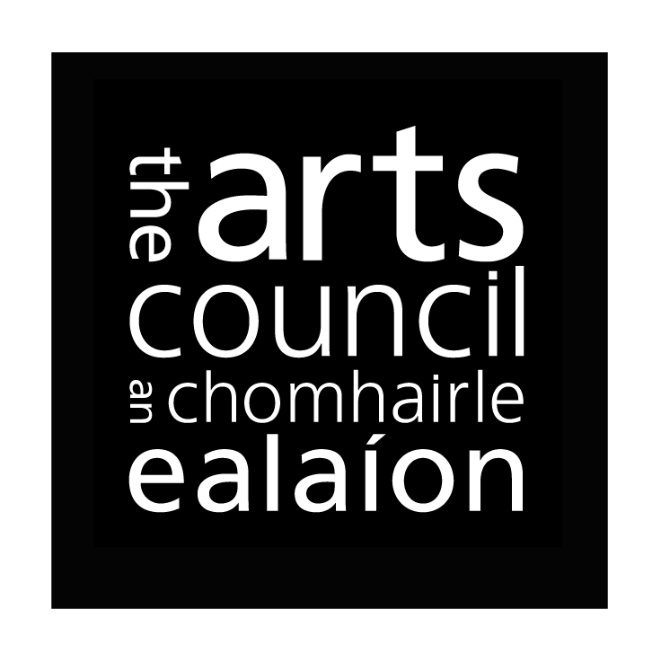
Arts Insight
The National Arts Engagement Survey 2020
Prepared by
John O’Mahony
J. 202201

Slide 2

Arts Insight 2020 Methodology
The purpose of the Arts Insights research series is to establish rigorous statistical measures on the Irish public’s attitudes and behaviours relating to arts and culture; and how this corresponds with other consumer and lifestyle behaviours.
The 2020 research builds off the findings from 2018 & 2019.
Nationally representative sample of 1,200 adults ages 16+:
  Quota controlled in terms of gender, age, region and area.
  Fieldwork was conducted in October/ November 2020.
Arts Insights 2020 was switched to an online approach due Covid-19 related public health restrictions. To support comparisons with the research series to date (conducted via face to face interviews) the national sample of interviews was increased to 1,200.

Slide 3
Arts Insight 2020 Sample Profile
Base: Adults aged 16+ n – 1,262
 |  | 2020 % |  |  |  | 2020 %
Gender | Male | 49 |  | Region | Dublin | 29
 | Female | 51 |  |  | ROL | 27
Age | 16-24 | 14 |  |  | Munster | 27
 | 25-34 | 16 |  |  | Conn/Ulster | 18
 | 34-49 | 28 |  | Area | Urban | 66
 | 50-64 | 23 |  |  | Rural | 34
 | 65+ | 18
Social Class | ABC1F | 49
 | C2DEF | 51

Slide 4
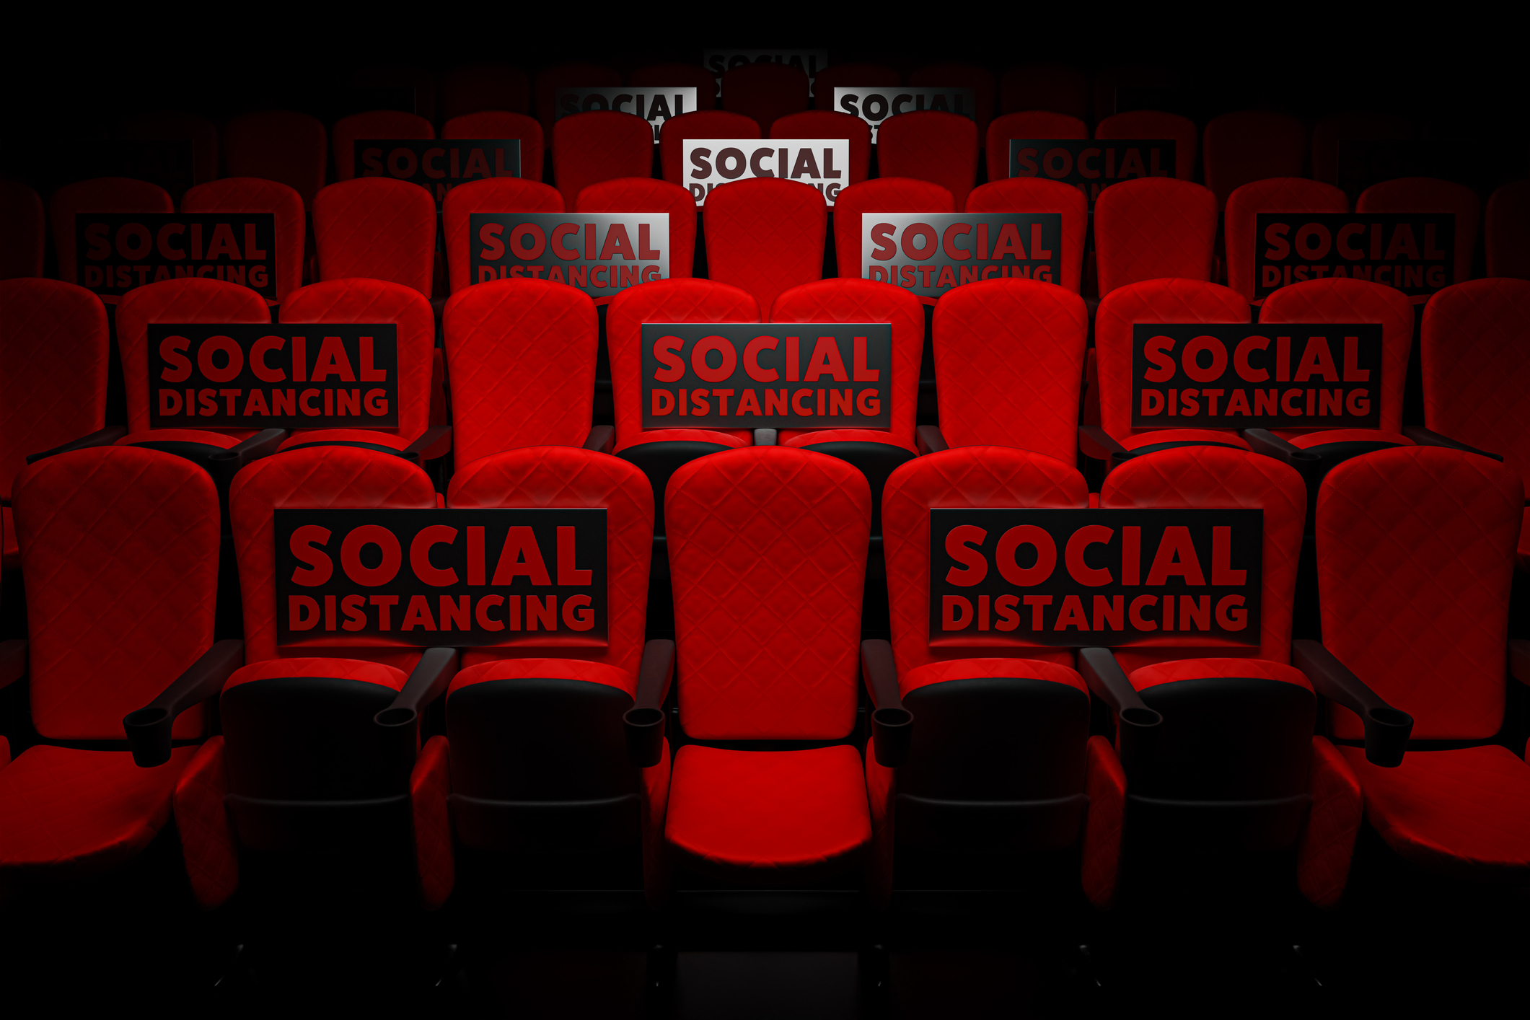
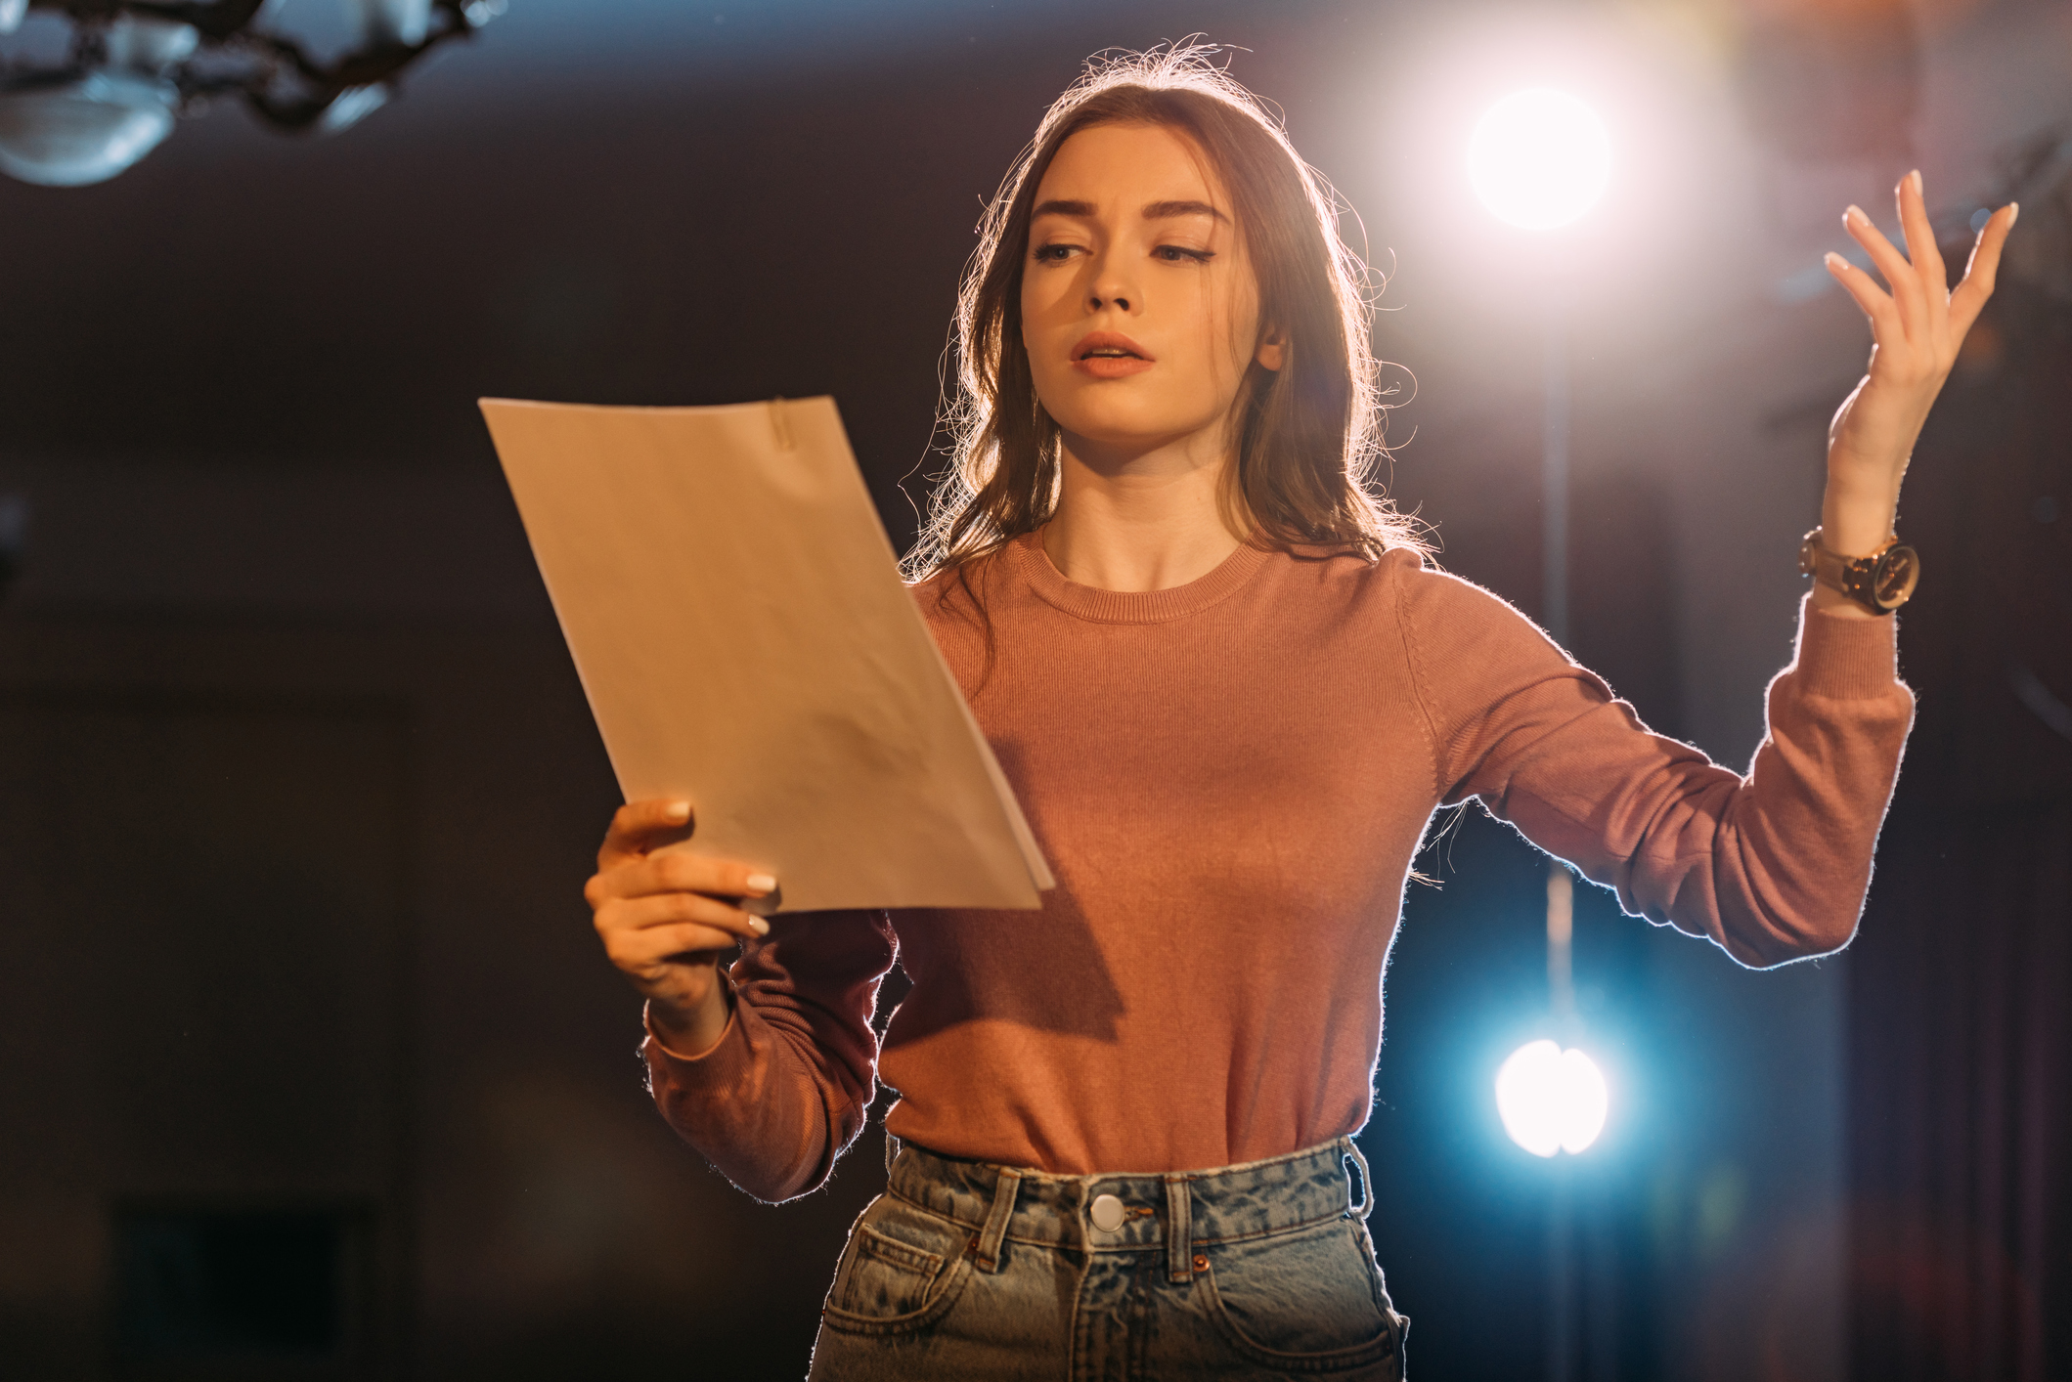


Arts Insights 2020 Summary Findings
ARTS ATTENDANCE
ARTS PARTICIPATION
ARTS SEGMENTATION
ATTITUDES TO THE ARTS
The impact of Covid-19
What have we done instead?
Our alternate activities have not adequately filled the vacuum left by live arts events.
We clearly want to return to live events (and we can prioritise what we need for that return).
Participation levels increase in 2020.
The motivations of enjoyment, self-expression and wellbeing.
We have adapted through switching to online and blended forms of participation.
However, the new approach has compensated only in part.
The importance of Aficionados.
‘Regulars’ within the Arts Sector are not to be underestimated however.
Age differences among Aficionados & Regulars.
Aficionados are the key target for paid online events.
Soft National Support for the Arts.
And support declines in 2020.
The sharpest falls relate to the role of the arts in communities and society.
Mental Wellbeing Issues are significant and most closely associated with age.

Slide 5

a
Arts Attendance
Arts Insight 2020

Slide 6
Arts attendance past 12 months 2020
Base: Adults aged 16+ n – 1,262
2018/19 Average
%
53
20
17
19
20
13
17
16
8
10
5
7
6
14
5
7
7
4
7
4
2
6
79
60
2020
 | %
*
Understandably Arts attendance has declined in past 12 months with the overall incidence declining to 64%; and 42% for Arts Council funded events*.
* Based on events traditionally funded by The Arts Council: excludes films, musicals, stand up comedy, rock or popular music
Q.2 In the past 12 months, have you been to any of these events?

Slide 7
Arts attendance past 12 months 2020: The Impact of COVID 19
Base: Adults aged 16+ n – 1,262
Throughout this survey we would like you to think back over the past 12 months: from October 2019 to now. Think of the past 12 months in full, including before and after the Covid 19 crisis in Ireland.
2020 Attendees* %
2020
Attendances
-30%
-45%
42%
Incidence of attendees at arts events typically funded by the Arts Council is down by 30%; number of attendances is down 45%
* Based on Arts Council Funded Event Attendance: events traditionally funded by the Arts Council: excludes films, musicals, stand-up comedy, rock or popular music
Q.2 In the past 12 months, have you been to any of these events?
Q.4 Which of the following best describes how often you have attended (INSERT FROM Q.2) in the past 12 months? Think of the past 12 months in full, including before and after the Covid 19 crisis.

Slide 8

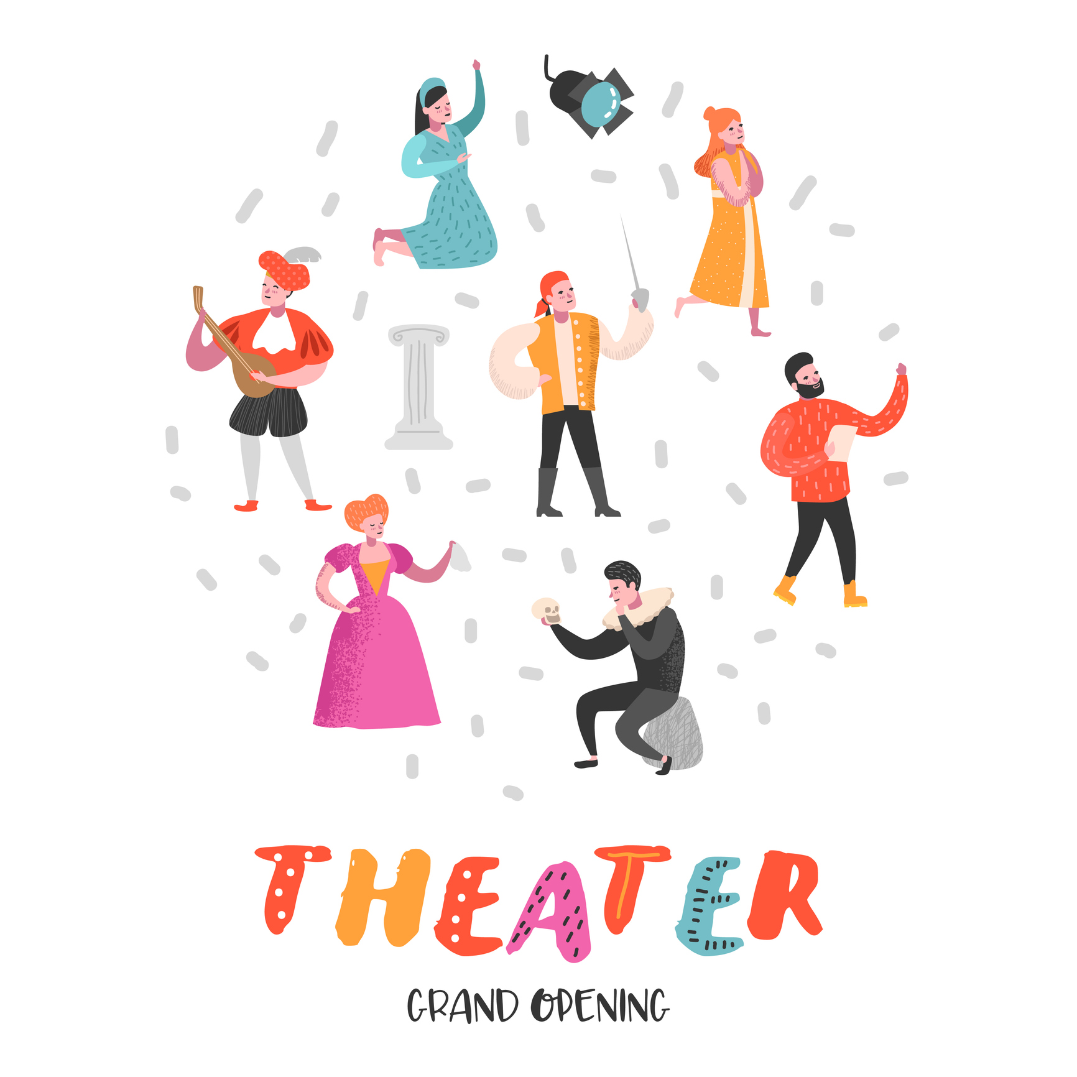
Incidence of attendees at arts events typically funded by the Arts Council is down by 30%. Number of attendances is down 45%
What have we done instead?

Slide 9



Striking rise in watching or listening to ‘Arts & Cultural programmes’
Base: Adults aged 16+ n – 1,262
Watched or listened to ‘Arts & Cultural programmers’
75%
on television
(up from 65%)
60%
online
(up from 27%)
58%
on radio
(up from 52%)
Q.24c Thinking now of the past 12 months, how frequently, if at all, have you watched or listened to arts & cultural programme on each of the TV, Radio and Online? Think of the past 12 months in full, including before and after the Covid 19 crisis.

Slide 10
Strong increase in our use of on demand media generally
2018/19 Avg
%
72
35
32
33
Base : All Adults N – 1,262
%
46
45
40
19
11
5
12
16
10
6
The rise in online engagement is confirmed with striking rises across a range of online activities.
Q.24b And which of these do you do regularly now – say at least once a week?

Slide 11

We are also reading more
Base : All adults 16+ n-1,262
Read past 12 months
%
2018/19
%
75
44
28
24
22
11
18
59% of readers are doing so ‘more often’ since the start of the Covid-19 crisis
There has been a 23% rise in the incidence of Irish adults who are reading works of fiction, novels, stories or plays (67% have done so in the past 12 months vs 44% previously)
Q.1b Now since the start of the Covid 19 crisis in Ireland, so from March this year, have you taken part in each of these more often, less often, about the same or stopped all together?
Q.20aNow thinking of reading for pleasure, have you read any of the following in the past 12 months?

Slide 12
However, our alternate activities have not adequately filled the vacuum left by live arts events

Slide 13
35% are actively dissatisfied with the quality of the arts & cultural programme they have experienced Online since March
Base: watch/listen to Arts + Cultural programmes online N - 638
Q. And how satisfied are you with the quality of the arts & cultural programme you have watched or listened to Online since the start of the Covid 19 crisis, so from March this year? Please rate it on a ten point scale where ten means extremely satisfied and one means not at all satisfied.
%
9 – 10
7 – 8
1 - 6
 | (1/10)
Total | 6.9
Age
-34 years | 6.6
35-49 years | 6.6
50+ years | 7.3
Aficionados | 7.4
Online use more often since March | 7.2
Mean (1/10) | 6.9
Satisfaction levels with the online arts experience since March is modest; only the senior age group + Aficionados give a significant rating above 7/10. An inherent danger being that online arts are attracting new users only to turn them off with the quality.

Slide 14
Satisfaction levels with live Arts attendance have collapsed from 82% to 46% in 2020
Base : All Adults aged 16+ n- 1,262
2020 Total % |  | 2018/2019 Total %
Very happy
Fairly happy
Neither happy nor unhappy
Not Very happy
Not happy at all
46%
82%
We clearly want to return to live arts events.
Q.5 How happy or not are you with how often you attend these types of events in your leisure time?

Slide 15
Planning for the Return to Arts Venues

Slide 16
Pubs/ Hotels are key national venues for attending Arts events
Base: Attended any event in past 12 months n – 846
2018/19 Avg
%
60
34
23
35
17
16
12
13
30
19
11
8
15
11
3
%
Multiplex Cinema
Pub/hotel
Theatre
Art Gallery
Church
Concert Hall/Opera House
Other dedicated music/arts venue (e.g. Vicar Street in Dublin)
Library
Open air venue
Community centre
Local Arts Centre
Art house cinema
School Hall
Town Hall
Other
 | %
Dublin | 35
Ex Dublin | 30
Age
- 35 years | 31
35 years | 31
Pubs/ Hotels are second only to Multiplex Cinemas in terms of attendance
*includes Art House Cinema, Concert Hall/ Opera House, Local Arts Centre, Art Gallery, Theatre
Q.8 In which of the following venues have you attended an arts event in the past 12 months?

Slide 17
Aficionados are typically the most concerned with attending indoor arts events
Base: All adults aged 16+ n – 1, 043
Somewhat concerned | Very concerned
Aficionados
Very concerned
%
Music or other performance in a standing indoor venue
49
47
38
38
37
37
31
32
22
21
17
16
14
15
Concert Hall/Opera House (indoors)
Theatre, Music, Dance or talk in a seated indoor venue
Multiplex Cinema
Art Gallery (indoors)
Music or other performance at an outdoor venue
Street arts (e.g. outdoor based performance/ parade/ carnival/ circus)
Our general levels of concern attending indoor venues in particular remain very high; however levels can show a slight decline since June.
*Arts Council ‘Arts during COVID - 19’ National Survey October 2020
Q.2 How concerned are you about attending an arts event in the following venues ...

Slide 18

Culture Night 2020
Base : All adults 16+ n- 1,262
Awareness
Total
(1,262)
%
Attendance
(701)
%
Base
Base
Yes, watched on TV or Online
Yes, attended an event in person
No
Any 24%
(14% all adults)
Name awareness 2019
49%
Yes
No
46% of attendees are now ‘ more confident’ about attending events in person
Awareness for Culture Night has risen to 57% of Irish adults; with 14% viewing the event in some form.
Awareness and attendance levels are largely consistent demographically.
Q.21a Prior to this interview had you heard of Culture Night?
Q.21b Did you see any events on Culture Night this year?

Slide 19
What can venues do to encourage attendance?
Base: Adults aged 16+ n – 1043
More likely to visit a venue for a live arts performance if …
October 2020
June %
(54)
(N/a)
(45)
(39)
(44)
(32)
(16)
(7)
Almost half the population would be happy to go back to live events before all restrictions are lifted. However, capacity will be a big determinant: 50% capacity is the point where most people start feeling comfortable (Ref. Shaping Ireland’s Future: Entertainment & The Arts; November 2020)
 | %
There was a limit on the numbers attending so the venue is partially full
All attendees having their temperature checked prior to entering the venue
Being supplied with clinical face masks prior to entering the venue
Ticket prices were temporarily reduced for a period of time (until the end of the year)
Being supplied with clinical gloves and hand disinfectant prior to entering the venue
The bar area remains closed
You are required to sign a waiver prior to attending, absolving the venue of the risk of you being exposed to, or accidentally exposing others to coronavirus
Ticket prices were temporarily increased for a period of time (until the end of the year)
The reassurances provided by limited numbers, face masks and discounts has increased since June; note also the prominence of ‘temperature checks’.
*Arts Council ‘Arts during COVID - 19’ National Survey October 2020
Q.3 When stay-at-home requirements are lifted, to what extent would ... make you more or less likely to visit a venue for a live arts performance?

Slide 20
a
Participating in the Arts
Arts Insight 2020

Slide 21
Participation levels increase in 2020
Base : All Adults aged 16+ n- 1,262
Any participation in the Arts
2020 |  | 2018/19
% |  | %
In the year of the pandemic participation in the arts appears to have actually increased.
Q.15 In the past 12 months, have you taken part in any of the following activities?

Slide 22
Rises in specific activities include: visual arts & crafts; films & video making; and in uploaded to the Internet something creative or artistic that you created
Base : All adults 16+ n- 1262
2018/19 Avg.
%
6
7
6
4
7
5
5
7
3
4
1
3
27
Participating in the Arts
%
Rise in participation is evident across every demographic group/ and section of arts goers: peaks among Aficionados (57%) and ex Dublin (43%)
Q.15 In the past 12 months, have you taken part in any of the following activities?

Slide 23
The motivations of enjoyment, self-expression and wellbeing are the top ranked reasons for participation in the extraordinary year of 2020.
Base : Arts Participants n - 450
Reasons for participating in the Arts
2018/19 Ave. %
61
24
32
39
33
31
25
32
18
9
%
Enjoyment\pleasure
Develops my creativity and self-expression
Improves my quality of life\well-being
To learn new skills
Friends take part
Gets me out of the house
Helps me to feel part of a community
Improves my confidence
Participating in arts activities is a boost to my health
Other
Q.18b What were your reasons for taking part in …….?

Slide 24
We have adapted through switching to online and blended forms of participation
Base: Participate in any Arts activity N - 450
 | %
Taken part online | 31
Taken part in person (solo) | 26
Taken part both online and in person | 10
Not taken part since the start of the Covid 19 crisis in Ireland | 33
Any 67%
Only 1 in 3 have stopped participating due to the pandemic; 67% of participants have continued to do so.
Q.16b Since the start of the Covid 19 crisis have you taken part in ...

Slide 25
However, the new approach to participation has compensated only in part
Base : All adults aged 16+ n-1,262
Happy with level of participation in the Arts
2020
2018/19
Arts Participants 450 %
Arts Participants 329 %
Very Happy
Fairly Happy
Neither Happy nor unhappy
Not Very Happy
Not Happy at all
Very Happy
Fairly Happy
Neither Happy nor unhappy
Not Very Happy
Not Happy at all
Levels of unhappiness with participation rates (and forms) has increased significantly: satisfaction down from 91% of participants to 51% in 2020
Q.17a Overall, how happy or not are you with how often you take part in these type of arts activities in your leisure time?

Slide 26
a
Arts Attendance Segmentation
Arts Insight 2020

Slide 27
The importance of Aficionados
Base : All Adults aged 16+ n- 1,262
Total cross attendance
‘Past 12 months’
2020 % |  | 2018/19 %
“Occassionals” (1-2 Types)
“Regulars” (3-4 Types)
“Aficionados” (5+ Types)
Film only
None
The incidence of Aficionados has declined to 13% in 2020
Q.2 In the past 12 months, have you been to any of these events?

Slide 28
The importance of Aficionados
Base : All Adults aged 16+ n- 1,262
Share of Arts Events attendance
2020 % |  | 2018/19 %
Arts events %
(2.8)
(6.1)
(12.5)
Arts events %
(4.0)
(8.2)
(17.0)
“Occassionals” (1-2 Types)
“Regulars” (3-4 Types)
“Aficionados” (5+ Types)
However, Aficionados continue to account for c. 50% of all attendances.
Q.4 Which of the following best describes how often you have attended in the past 12 months? -

Slide 29
The demographic differences across the segments are rarely statistically significant
Base: All Adults aged 16+ n – 1,262
 | Total | Any Arts Goers | Occasionals | Regulars | Aficionados | Films (only) | None
UNWTD | 1262 | 671 | 282 | 213 | 176 | 174 | 417
 | % | % | % | % | % | % | %
Gender
Male | 49 | 49 | 53 | 43 | 50 | 45 | 50
Female | 51 | 51 | 47 | 57 | 50 | 55 | 50
Age
16-24 | 14 | 14 | 13 | 16 | 13 | 23 | 12
25-34 | 16 | 18 | 22 | 16 | 14 | 20 | 12
34-49 | 28 | 29 | 27 | 31 | 29 | 32 | 26
50-64 | 23 | 23 | 25 | 23 | 20 | 17 | 25
65+ | 18 | 16 | 13 | 14 | 23 | 8 | 25
Social Class
ABC1F50+ | 49 | 53 | 55 | 54 | 50 | 53 | 43
C2DEF50- | 51 | 47 | 45 | 46 | 50 | 47 | 57
Region
Dublin | 29 | 33 | 29 | 32 | 39 | 31 | 23
Ex. Dublin | 71 | 67 | 71 | 68 | 61 | 69 | 77
RoL | 27 | 23 | 27 | 21 | 20 | 28 | 31
Munster | 27 | 28 | 28 | 25 | 30 | 27 | 25
Conn/Uls | 18 | 16 | 15 | 22 | 11 | 14 | 21
Area
Urban | 66 | 73 | 74 | 70 | 73 | 68 | 56
Rural | 34 | 27 | 26 | 30 | 27 | 32 | 44

Slide 30
Even beyond attendance, Aficionados are the driving consumer force in the arts

Slide 31
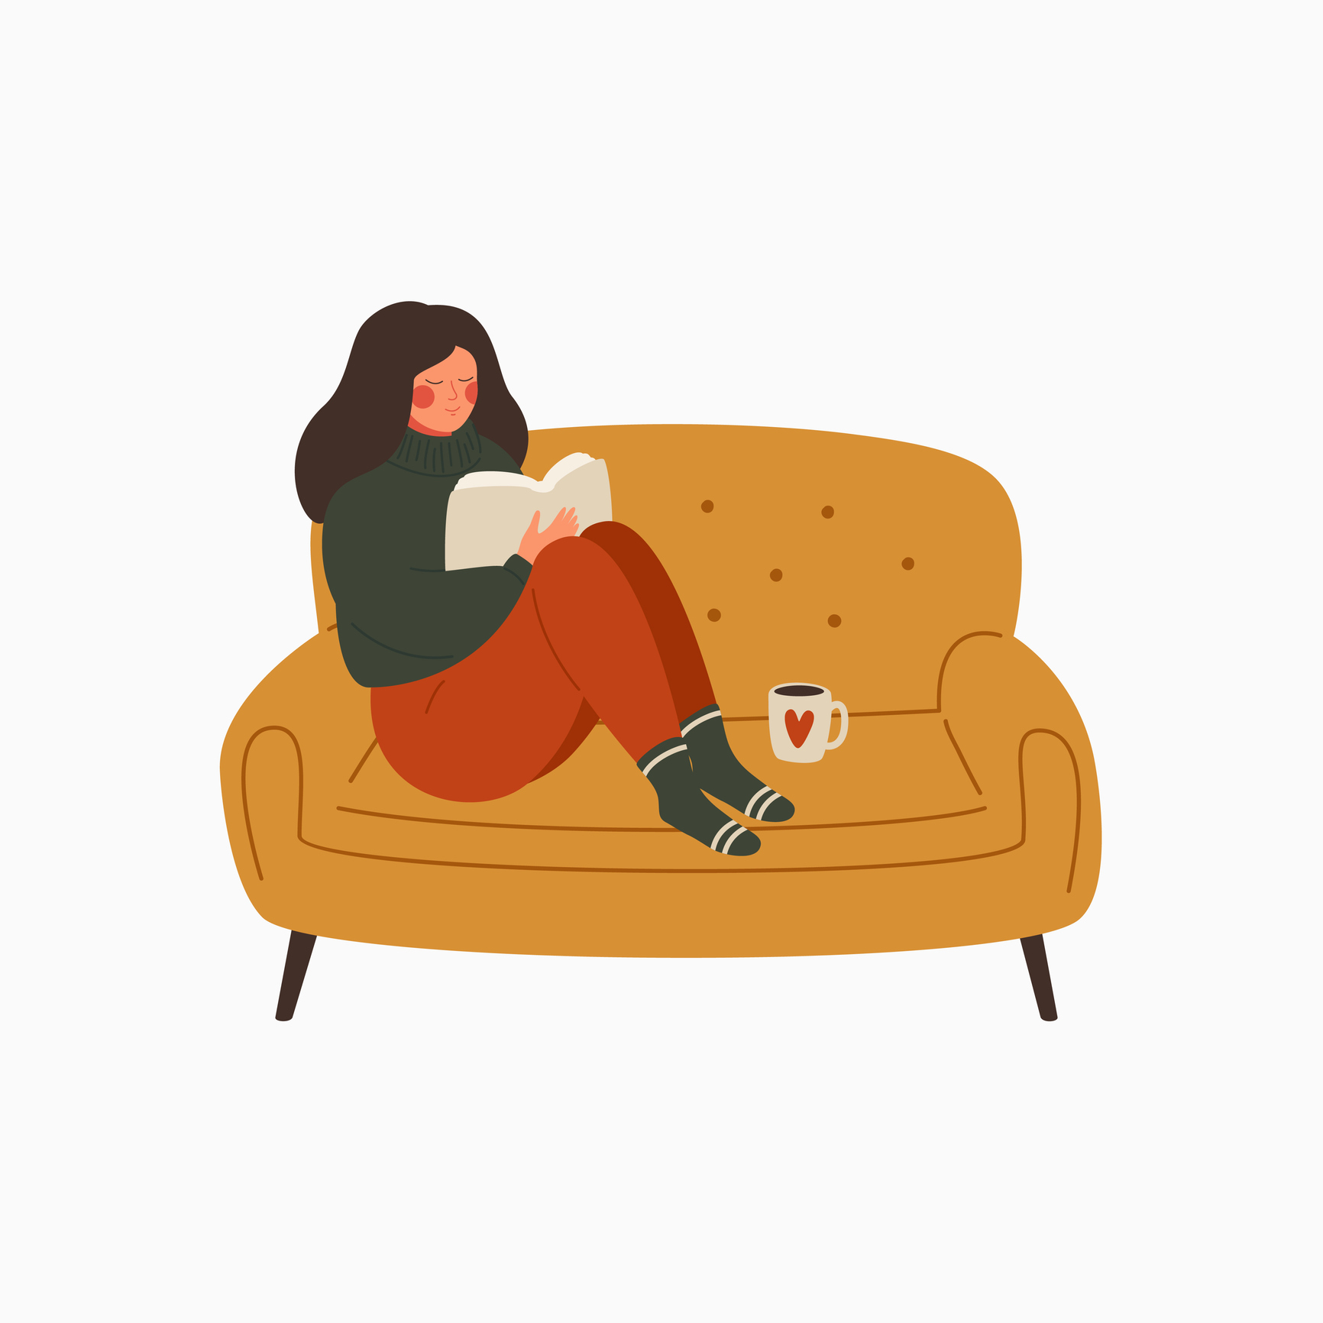
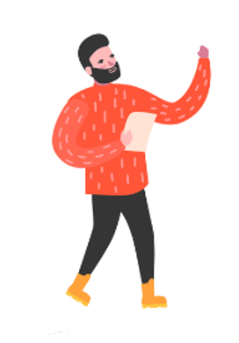



Aficionados are also more likely to:
Be arts participants
57% of Aficionados versus 34% Nationally
Read all types of literature
incl. Fiction 76% vs 67% Nationally, and Poetry 27% vs 15% Nationally
Support the arts
(donations, volunteering etc.)
51% vs 25% Nationally
Consume any digital arts/ drama
70% vs 32% Nationally
And to have the most positive general attitudes towards the arts
‘strongly agree’ average 44% vs 24% Nationally
Q.15 In the past 12 months, have you taken part in any of the following activities? By ‘take part’ I mean in your free time in the home, in classes, rehearsals, shows or in workshops — other than as part of your job or in full time education. Think of the past 12 months in full, including before and after the Covid 19 crisis.
Q.19 Which, if any, of the following have you personally done in the past 12 months?
Q.20a Now thinking of reading for pleasure, have you read any of the following in the past 12 months?
Q.24a Which of these have you done at home or while you’re travelling/ on the go in the past 12 months?
Q.30How much do you agree or disagree with each of the following statements:

Slide 32
‘Regulars’ within the Arts Sector are not to be underestimated however
Base : All Adults aged 16+ n- 1,262
Total cross attendance ‘Past 12 months’
Total Cross Attendance 2020 %
Share of Arts events attendance
2020
%
No. of Arts attendance
2020
(2.8)
(6.1)
(12.5)
“Occassionals” (1-2 Types)
“Regulars” (3-4 Types)
“Aficionados” (5+ Types)
Film only
None
They account for 16% of all adults; and 30% of all arts attendances. They attend on average twice as many arts events as ‘Occasionals’ – 6.1 vs 2.8 times per annum.
Q.2 In the past 12 months, have you been to any of these events?
Q.4Which of the following best describes how often you have attended (INSERT FROM Q.2) in the past 12 months? Think of the past 12 months in full, including before and after the Covid 19 crisis.

Slide 33
Aficionados & Regulars – an Uber Arts Group
Base : All Adults aged 16+ n- 1,262
Share of Arts Events attendance
2020 %
Arts events %
(2.8)
(6.1)
(12.5)
“Occassionals” (1-2 Types)
“Regulars” (3-4 Types)
When combined into a single Uber Arts group, Aficionados & Regulars exhibit interesting patterns by age
“Aficionados” (5+ Types)
Q.4 Which of the following best describes how often you have attended in the past 12 months? -

Slide 34


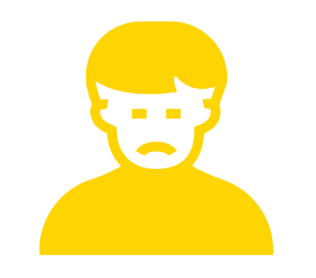
Age differences within Aficionados & Regulars
 | -35 Years (30%) | 35-49 Years (30%) | 50 years+ (40%)
Those 50 years+ are easily the most likely to want to attend Arts Council funded events more often (95% vs 66% nationally)
35-49-year olds over index in wanting to see more Stand Up Comedy
Those under 35 years over index in wanting to see more Rock or Popular music; and more Plays
The youngest and oldest of this Uber Arts group are the most likely to have paid to view online arts
Those 50 years+ are much more satisfied with the quality of the arts & cultural programme they have experienced Online since the start of the crisis. (7.6/10 vs 6.9)
The oldest group are also much more likely to be both aware and to have attended Culture Night
General attitudes towards the arts are equally positive across the three age groups:
The biggest distinction relates to the relative quality of Irish arts: the older age group are far more likely to agree that...The quality of professional arts presented in Ireland are on a par with those you would experience in any European country
Q.4 Which of the following best describes how often you have attended in the past 12 months?

Slide 35
Who is the key target for paid online events?

Slide 36
In the past year, 13% of Irish adults have paid to view online arts performances
Base : All adults 16+ n-1,262
grows to 20% of Arts Goers and peaks at 30% of Aficionados
Any Pay per view
13%
youngest and oldest of Aficionado + Regular group are most likely to have paid to view online arts
Q.19 Which, if any, of the following have you personally done in the past 12 months?

Slide 37
Are we as a nation happy to pay to watch The Arts online?
Base : All Adults aged 16+ n- 1,262
“I am happy to pay to watch professional arts events online”
%
Strongly Agree
Rises to 54% among under 24 years.
41%
Agree
And peaks at 63% among Aficionados
Neither
Disagree
Strongly Disagree
Q.30 How much do you agree or disagree with each of the following statements

Slide 38
25% of Irish adults generally support the arts (donations, volunteering etc.)
Base : All adults 16+ n-1,262
Any Support
25%
Rising to 51% among Aficionados
Q.19 Which, if any, of the following have you personally done in the past 12 months?

Slide 39
The indications are the key target market for paid online arts events exactly mirrors that of in person live events – Aficionados
(but don’t forget young Regulars)

Slide 40
a
Attitudes to the Arts
Arts Insight 2020

Slide 41
While National Support for the Arts is well evident, is it ‘soft support’?
Base : All adults 16+ n-1,262
General attitudes indicate a considered rather than strong positivity towards the arts
c. 1 in 3 adults are neither happy nor unhappy with their level of attendance at Arts Events in the past 12 months
Attitudes to The Arts (Summary)
2020
%
Total
2020
%
Very happy
Fairly happy
Neither happy nor unhappy
Not very happy
Not happy at all
Strongly Agree
Agree
Neither
Disagree
Strongly Disagree
Overall, national attitudes may suggest a somewhat gentle affinity
to the role and importance of the arts in our lives
Q.30How much do you agree or disagree with each of the following statements
Q.5 Overall, how happy or not are you with how often you attend these types of events in your leisure time?

Slide 42
Attitudinal support declines in 2020
Strongly Agree
%
2018/19
%
Base : All Adults n - 1262
Ireland is a creative nation
The arts in Ireland should receive public funding
As much importance should be given to providing arts amenities as is given to providing sports amenities
Art education in schools (e.g. dance, drama, music, etc.) is as important as science education
The arts from different cultures give us an insight into the lives of people from different cultures
The arts play an important and valuable role in Irish society
Ireland’s reputation for the arts helps bring visitors and tourists to Ireland
The arts make for a richer and more meaningful life
The arts in Ireland are underfunded
The arts help us express and define what it means to be Irish
The quality of professional arts presented in Ireland are on a par with those you would experience in any European country
The arts locally help give my county or region a distinctive identity
I am happy to pay to attend Professional Arts events
I cannot afford to attend as many arts events as I might wish
There are equal opportunities for everyone living in Ireland to attend and participate in the arts, (regardless of class, age, ethnicity, disability etc)
The arts play a significant part in my life
Involvement in the arts makes me feel a stronger connection to where I live
I am happy to pay to watch Professional Arts events online
37
36
33
34
36
35
34
33
26
31
N/a
27
N/a
23
23
19
23
N/a
In this exceptional year, positive attitudes towards the arts have declined: from a ‘strongly agree’ average of 31% previously to 24% in 2020. This weaker attitude shows a strong consistency across all demographic groups
Q.30 How much do you agree or disagree with each of the following statements

Slide 43
The sharpest falls relate to the role of the arts in communities and society
2018
%
Strongly Agree
%
Base : All Adults n - 1262
37
36
33
34
36
35
34
33
26
31
N/a
27
N/a
23
23
19
23
N/a
Ireland is a creative nation
The arts in Ireland should receive public funding
As much importance should be given to providing arts amenities as is given to providing sports amenities
Art education in schools (e.g. dance, drama, music, etc.) is as important as science education
The arts from different cultures give us an insight into the lives of people from different cultures
The arts play an important and valuable role in Irish society
Ireland’s reputation for the arts helps bring visitors and tourists to Ireland
The arts make for a richer and more meaningful life
The arts in Ireland are underfunded
The arts help us express and define what it means to be Irish
The quality of professional arts presented in Ireland are on a par with those you would experience in any European country
The arts locally help give my county or region a distinctive identity
I am happy to pay to attend Professional Arts events
I cannot afford to attend as many arts events as I might wish
There are equal opportunities for everyone living in Ireland to attend and participate in the arts, (regardless of class, age, ethnicity, disability etc)
The arts play a significant part in my life
Involvement in the arts makes me feel a stronger connection to where I live
I am happy to pay to watch Professional Arts events online
This may reflect the very absence of the arts from our ‘out of home’ lives in the past 9 months.
Q.30 How much do you agree or disagree with each of the following statements

Slide 44
Mental Wellbeing Scale (MWS)
The WEMWBS, developed by Warwick and Edinburgh Universities, uses a set of 14 positively worded statements about specific thoughts and feelings, with five response categories to determine how often an individual has experienced them; this is used to assess mental wellbeing. A shortened version of the tool, called SWEMWBS³, with 7 items, was used in the survey, to allow for analysis of any difference in response patterns according to mental wellbeing. Each of the 7 items carried a score between 1 and 7, giving individual participants an overall score between 7 and 35, with a lower score denoting a lower level of mental wellbeing. For the purpose of analysis in this report the level of mental wellbeing has been assessed as either low, medium or high.
Questions | Score
 | None of the time | Rarely | Some of the time | Often | All of the time
I’ve been feeling optimistic about the future | 1 =1 | 2=2 | 3=3 | 4=4 | 5=5
I’ve been feeling useful | 1 | 2 | 3 | 4 | 5
I’ve been feeling relaxed | 1 | 2 | 3 | 4 | 5
I’ve been dealing with problems well | 1 | 2 | 3 | 4 | 5
I’ve been thinking clearly | 1 | 2 | 3 | 4 | 5
I’ve been feeling close to other people | 1 | 2 | 3 | 4 | 5
I’ve been able to make up my own mind about things | 1 | 2 | 3 | 4 | 5
³ Stewert-Brown, S. Tennant, A, Tennent, R. Platt, S., Parkinson, J. and Weich, S. (2009) Internal construct validity of the Warwick-Edinburgh Mental Well-being Scale (WEMWBS): a Rasch analysis using data from the Scottish Health Education Population Surve. Health and Quality of Life Outcome. 7:15 doi:10.1186/1477-7525-7-15

Slide 45


In this broader measure, the Mental Wellbeing Scale (MWS) indicates that 40% of Irish adults are currently classified in the ‘Low’ group
Base: Adults aged 16+ n – 1,262
Mental Wellbeing
2020
%
High
Medium
Low
Q.16 Below are some statements about feelings and thoughts related to general wellbeing.
Please indicate for each of the following statements which is closest to how you have been feeling over the last two weeks.

Slide 46
Mental Wellbeing Issues are most closely associated with age - the ‘Low’ group rising to 50% of those aged under 35 years
Base: Adults aged 16+ n – 1,262
(MWS) | Total | Age |  |  | Arts Goers |  |  |  |  |  | Participation
 |  | >34 | 35-49 | 50+ | Any arts goers | Occasional | Regular | Aficionados | Films at a cinema or other venue (ONLY) | None | Participants | Non-Participants
 | 1262 | 364 | 402 | 496 | 671 | 282 | 213 | 176 | 174 | 417 | 450 | 812
 | % | % | % | % | % | % | % | % | % | % | % | %
Low | 40 | 50 | 44 | 29 | 39 | 36 | 43 | 39 | 39 | 41 | 38 | 40
Medium | 43 | 38 | 42 | 47 | 44 | 46 | 42 | 43 | 45 | 40 | 42 | 43
High | 18 | 13 | 14 | 24 | 17 | 17 | 15 | 18 | 17 | 20 | 20 | 17
The unsettling incidence of the ‘low’ group does not peak further among Arts Goers
Q.33 Please indicate for each of the following statements which is closest to how you have been feeling over the last two weeks ...

Slide 47
The Arts + COVID 19: Attitudes
Base : All Adults n - 1262
Not being able to participate in the arts during the Covid-19 crisis has been difficult for me
%
The Arts more than ever are important for my mental health
%
Strongly Agree
Agree
Neither agree nor disagreed
Disagree
Strongly disagree
Art Goers | 61%
Aficionados | 77%
Art Goers | 46%
Participants | 51%
Aficionados | 77%
NET (Agree) | 51
33
61% of Arts Goers agree that The Arts more than ever are important for my mental health; and 46% agree that Not being able to participate in the arts during the Covid 19 crisis has been difficult for me
Q.34 How much do you agree or disagree with each of the following statements: ...

Slide 48
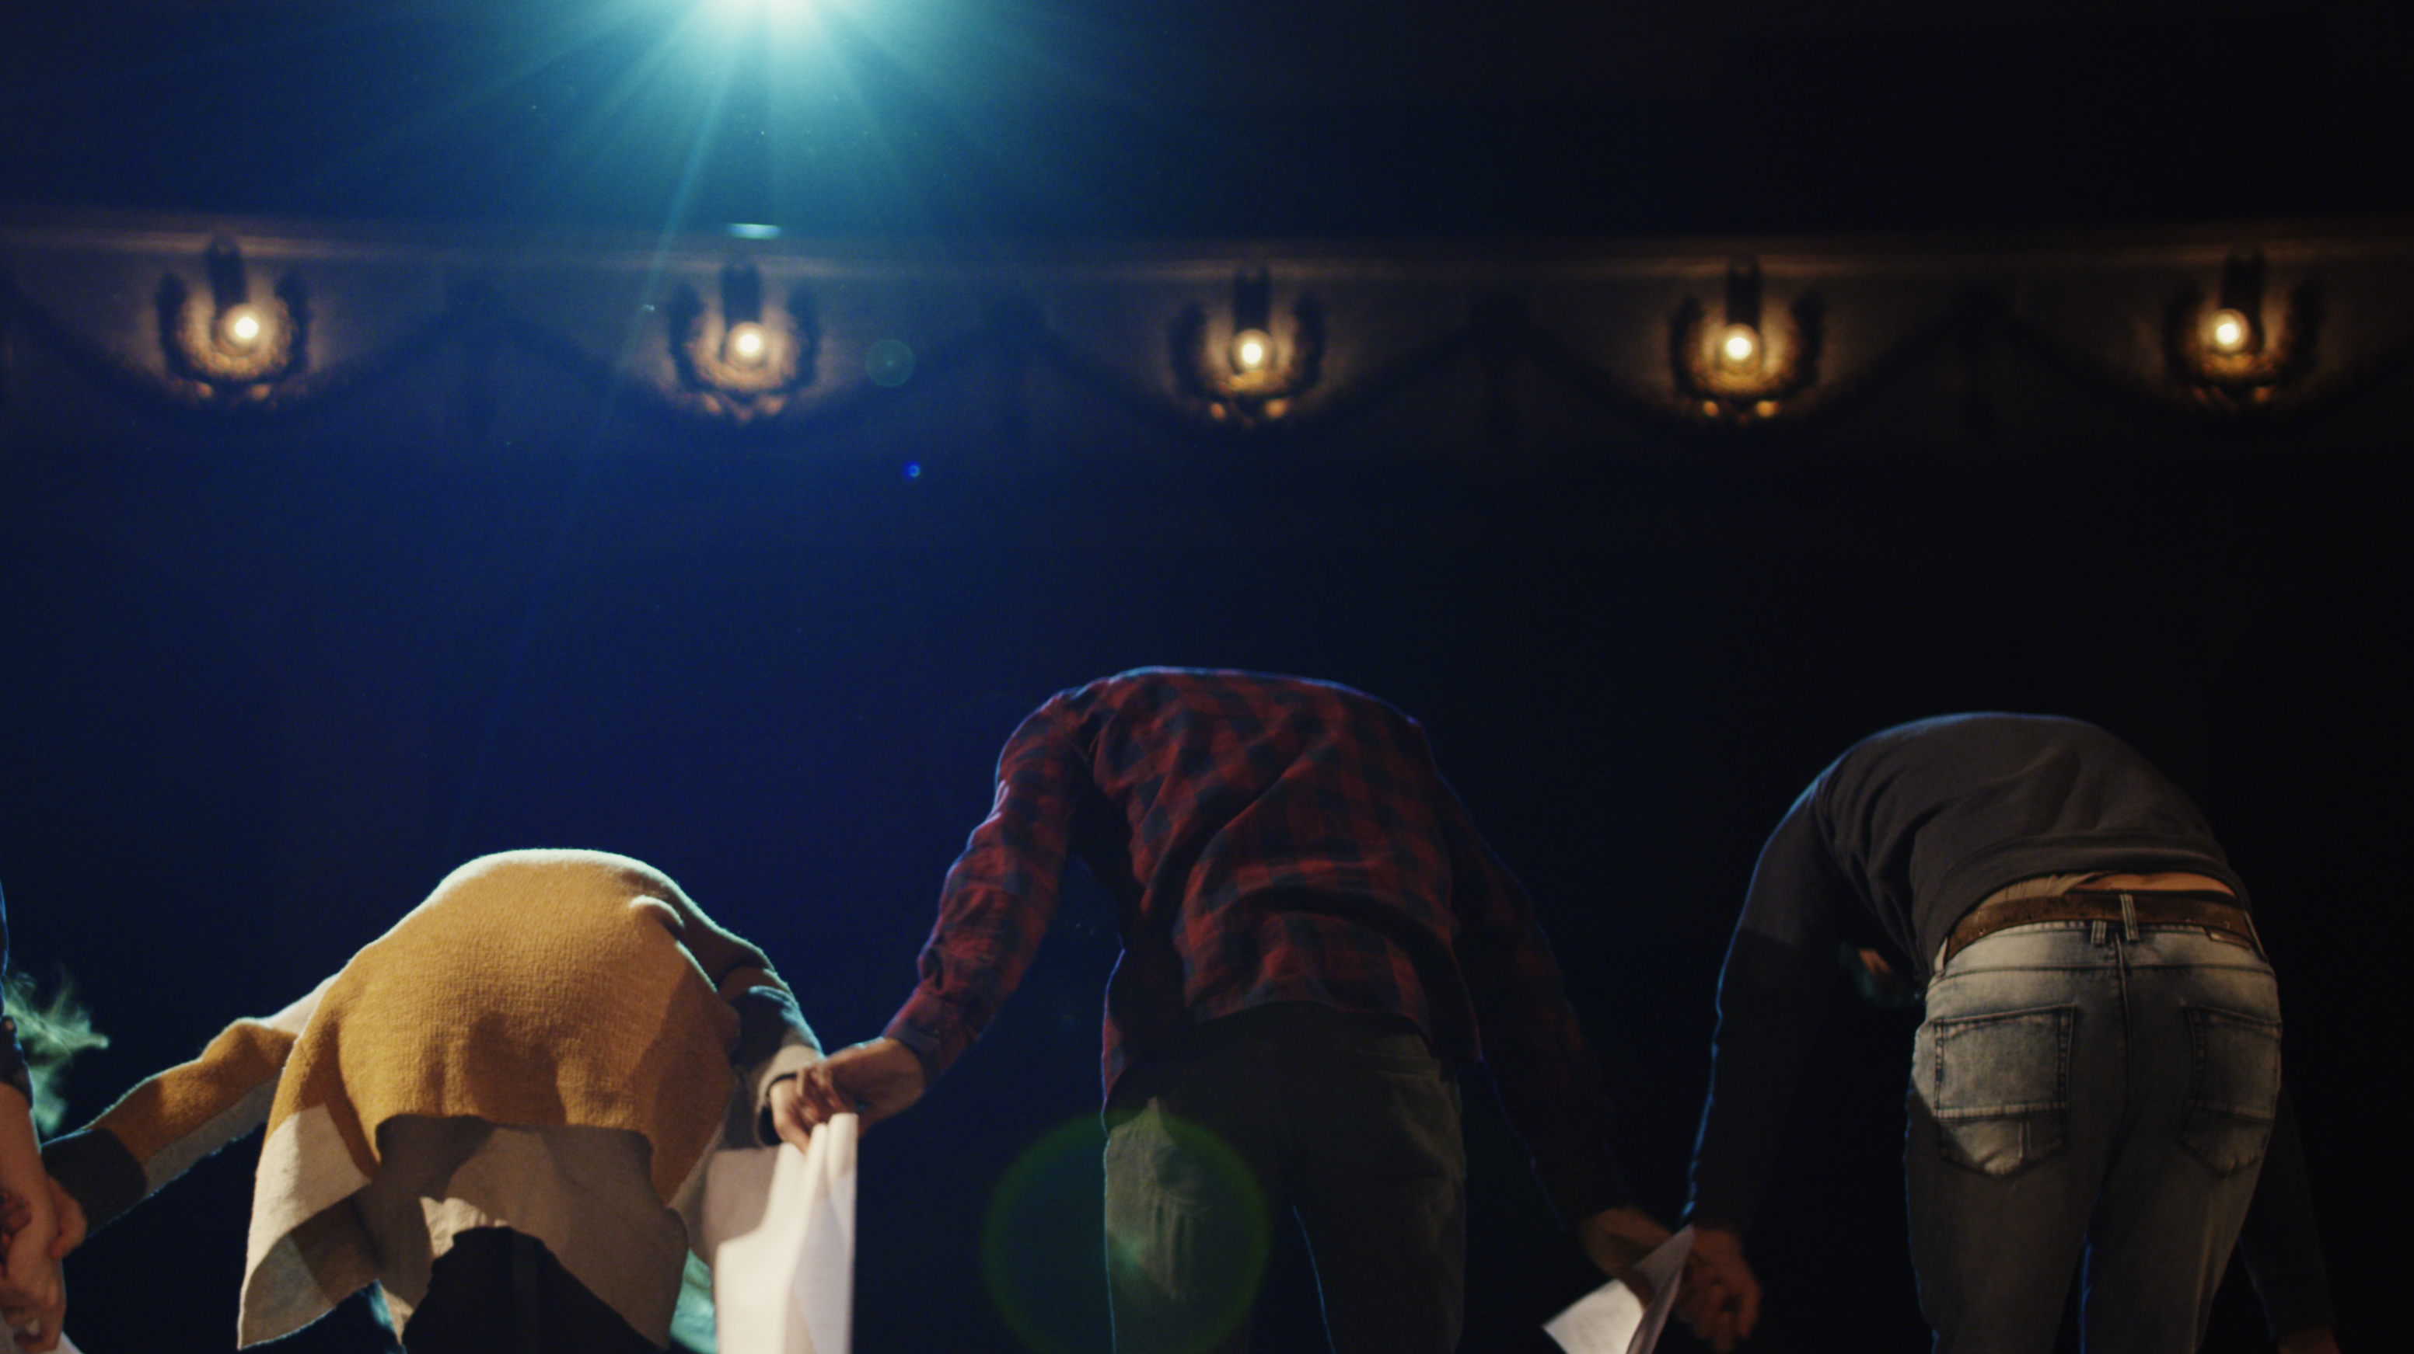
a
Summary and Conclusions
Arts Insight 2020

Slide 49
ARTS INSIGHTS 2020 KEY LEARNINGS
1.
2.
3.
The survey results confirm the severe impact of the global pandemic on the Irish Arts Sector.
Irish adults have tried to compensate for the absence of live events through consuming arts online as well as an increase in on demand media use generally; there has also been a rise in reading, especially fiction.
Participation levels in the arts have actually increased in 2020, facilitated through switching to online and blended forms of participation; and motivated by the enjoyment, self-expression and wellbeing derived from engaging in the arts.
4.
5.
6.
7.
However, our adapted forms of consumption and participation have only compensated in part – satisfaction with the online arts offering to date is modest and we clearly very much miss live in person engagement.
The sector faces the twin challenges and opportunities of offering quality online alternatives while preparing for an audience highly motivated to return to the ‘real thing’.
Irrespective of the form of engagement, Aficionados remain the cornerstone of public support for the arts and present the core target for paid online offerings. Notwithstanding this, ‘Regulars’, especially those under 35 years, present a further important target.
The national mood can be characterised as ‘depressed’ with concerning indications of mental wellbeing generally and especially among younger adults. Overall, positive attitudes towards the arts have declined, with the sharpest falls relating to their role in communities and society; likely of course reflecting the very absence of the arts from our ‘out of home’ lives in the past 9 months of this horrid year.

Slide 50

Thank you.
Milltown House
Mount Saint Annes
Milltown, Dublin 6 - D06 Y822
+353 1 205 7500 | www.banda.ie

