Slide 1
Youth Consultation

Slide 2
Reflection:
A time a decision was made about you and you weren’t consulted
A time you felt heard

Slide 3
National Framework
The participation of children and young people in decision-making involves taking children and young people seriously and where possible responding to their suggestions, ideas and views in an appropriate and timely manner.

Slide 4
Emerging Evaluation:
“The Creative Schools initiative has transformed a very broad range of Irish schools, more than any other initiative heretofore by placing learners in every county at the heart of the process, valuing and validating their perspectives and experiences. Creative Schools has been collaborating meaningfully with learners and educators to shift the focus of arts education from child-centred to child-led creative participatory practice”.

Slide 5
Article 12 UNCRC (The Participation Article)
“State Parties shall assure to the child who is capable of forming his or her own views the right to express those views freely in all matters affecting the child, the views of the child being given due weight in accordance with the age and maturity of the child”.

Slide 6
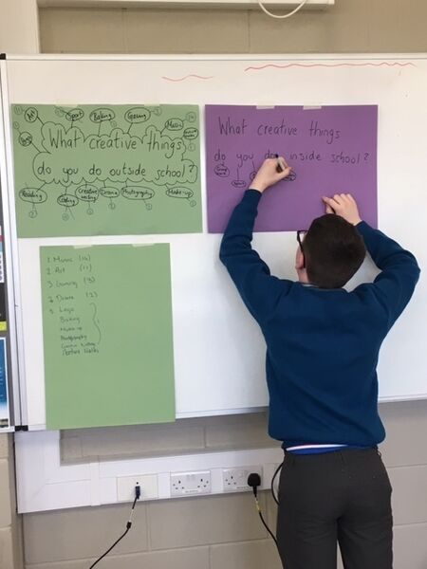
Macro and Micro
Macro level: children’s views should be taken into account in the development of national policies and in the design of services.

Slide 7
Micro level: children’s views should be taken into account in the individual decision-making that affects their daily lives. The UN Committee has highlighted the relevance of children’s involvement in decision-making in schools and local communities, given that these are the spaces where many important decisions are taken that directly affect their lives.

Slide 8
Framework for Participation: Lundy Model

Slide 9
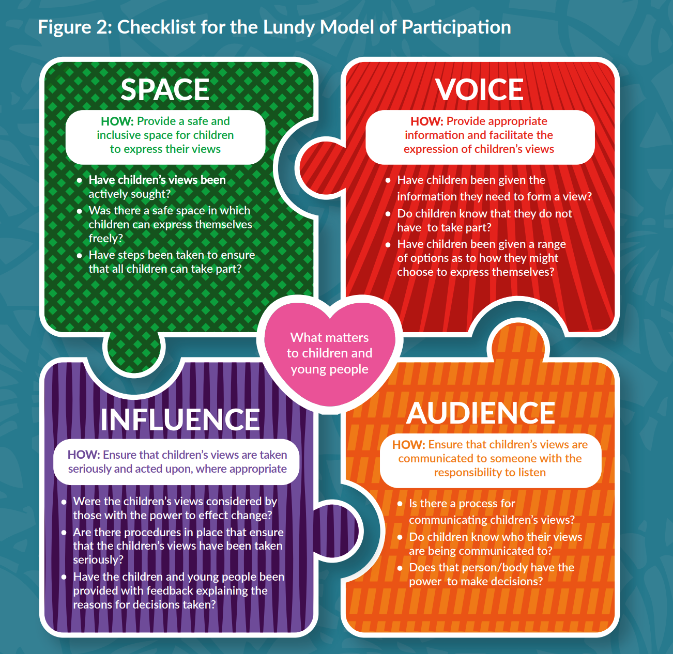
Checklist for the Lundy Model of Participation

Slide 10
Seldom-heard
Is a term used to describe children and young people who have fewer opportunities to participate and/or who encounter more obstacles when attempting to participate, including but not limited to seldom heard children and young people who are:
(Seldom Heard Toolkit)

Slide 11
Being bullied
In care
Experiencing domestic violence
From a minority ethnic background
Homeless or at risk of losing their home / living in temporary / unsuitable accommodation
In hospital (including those with mental health issues)
Lesbian, gay, bisexual, transgender (LGBT)
Living in poverty
Living in rural isolation
Living with mental health issues
Living with parental addiction
Living with strained family relationships
Not in school
Persons with physical and intellectual disabilities
Refugees and asylum-seekers
Travellers
Unemployed.

Slide 12
What it isn’t:
Young people tell you what they want and you have to action it
It must always be formal
Children will be in charge of the project
You will have to submit your decisions to young people for approval
Children will manage the budget of the project
If you can’t do it perfectly don’t start

Slide 13
What it is
There is a growing body of evidence on the benefits of participation by children and young people in decision-making across a range of measures, including improved services, policies, research, active citizenship and, most importantly, improvements for children themselves and for society generally (Kilkelly et al, 2014).
Inclusion of children and young people in decision-making can promote children’s protection, and improve their confidence, communication skills and ability to negotiate, network, and make judgements (Franklin and Sinclair, 2000).
(From Seldom Heard Toolkit)

Slide 14
Lessons from Current Practice
There’s no one ‘right way’ and there’s no one ‘right answer’
Your best ideas will be creative problem solving (like the rest of your work)
Consultation and Participation aren’t separate from the work…it is the work
The best programmes are supported by a good working partnership
with the school that leverages everyone’s skills
There will be challenges – it doesn’t mean something is going wrong
Facilitating self expression and facilitating decision making are not the same thing.

Slide 15
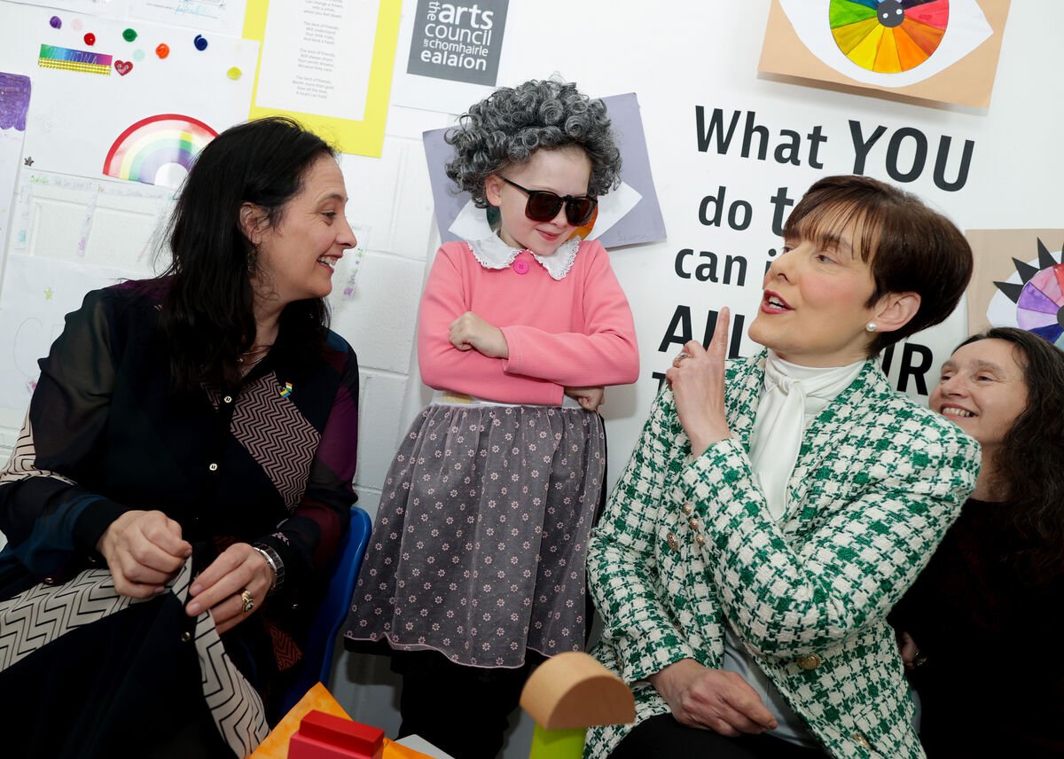
Rule of thumb:
“Nothing about us, without us”

Slide 16
‘Although where you are going is infront of you, there is no such thing as straight ahead’
Jeannette Winterson, The Passion

Slide 17
Things to think about in the coming weeks
Think about the four dimensions of the Lundy Framework and how to start with making space
Start with what you’re already good at and you’re already doing
How will you involve seldom heard young people?
You’re already on your journey …and you’re going to be brilliant ☺

Slide 18
Resources
Lundy model, framework, checklist and other tools:
https://hubnanog.ie/participation-framework/
Seldom heard toolkit: A Practical Guide to Including Seldom Heard Children and Young People in Decision Making
https://www.comhairlenanog.ie/wpcontent/uploads/2014/10/Seldom-Heard-toolkit.pdf
National Strategy on Children and Young People’s Participation in Decision Making:
https://www.gov.ie/en/publication/9128db-national-strategy-on-children-and-young-peoples-participation-in-dec/
Notes:
Some resources you might find useful.

Slide 19
Discuss and agree one way that each item in the box can be used to support consultation.
Write each on a separate slip of paper.

Slide 20
Reflection:
One thing I noticed was....
...and I think the facilitator chose to do it that was because...
...and I think the impact on participants would be...

