Slide 1
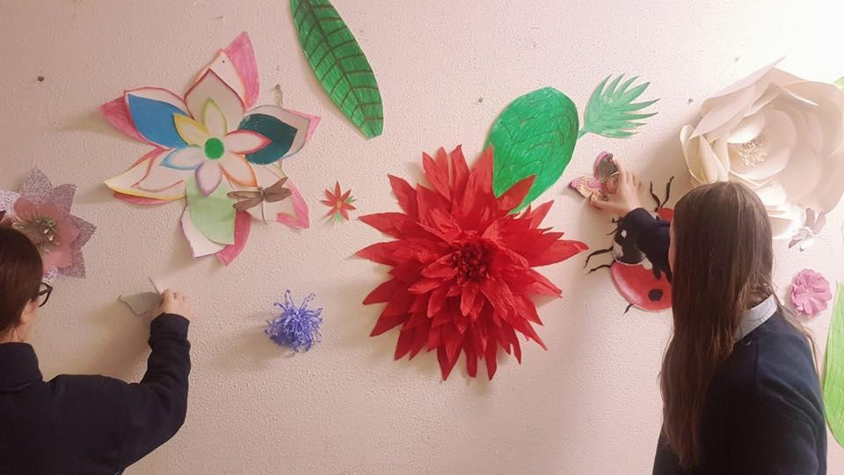
Coláiste Mhuire, Ballygar 2018 - 2020
Creative Schools Case Study
Creative Associate Training 2023
Creative Associate Joanna McGlynn

Slide 2
Context:
Approx 250 students
21 staff
Galway / Roscommon border
School Coordinator = Art Teacher

Slide 3
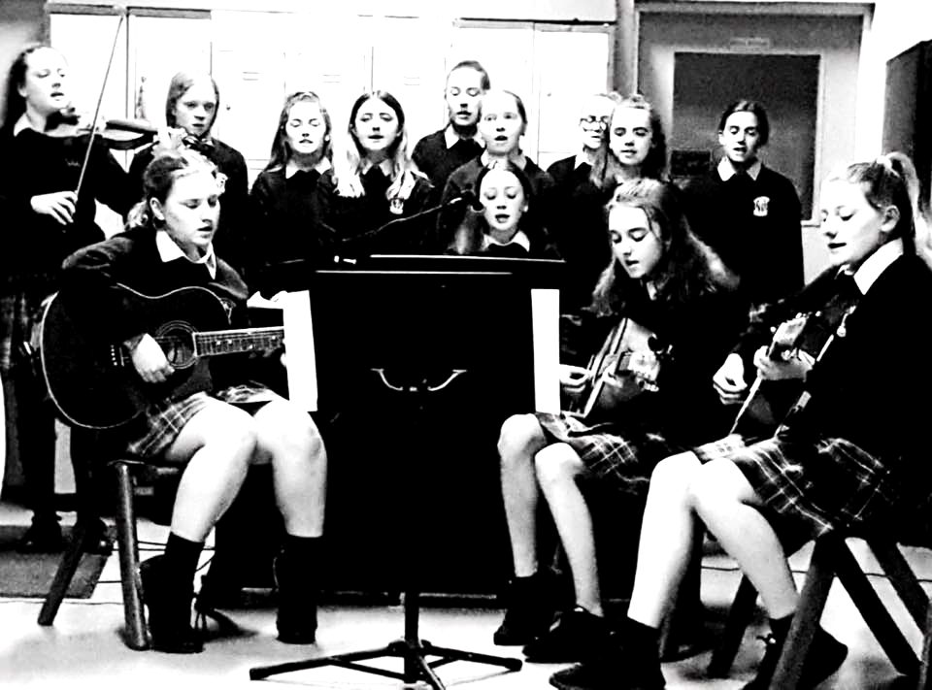
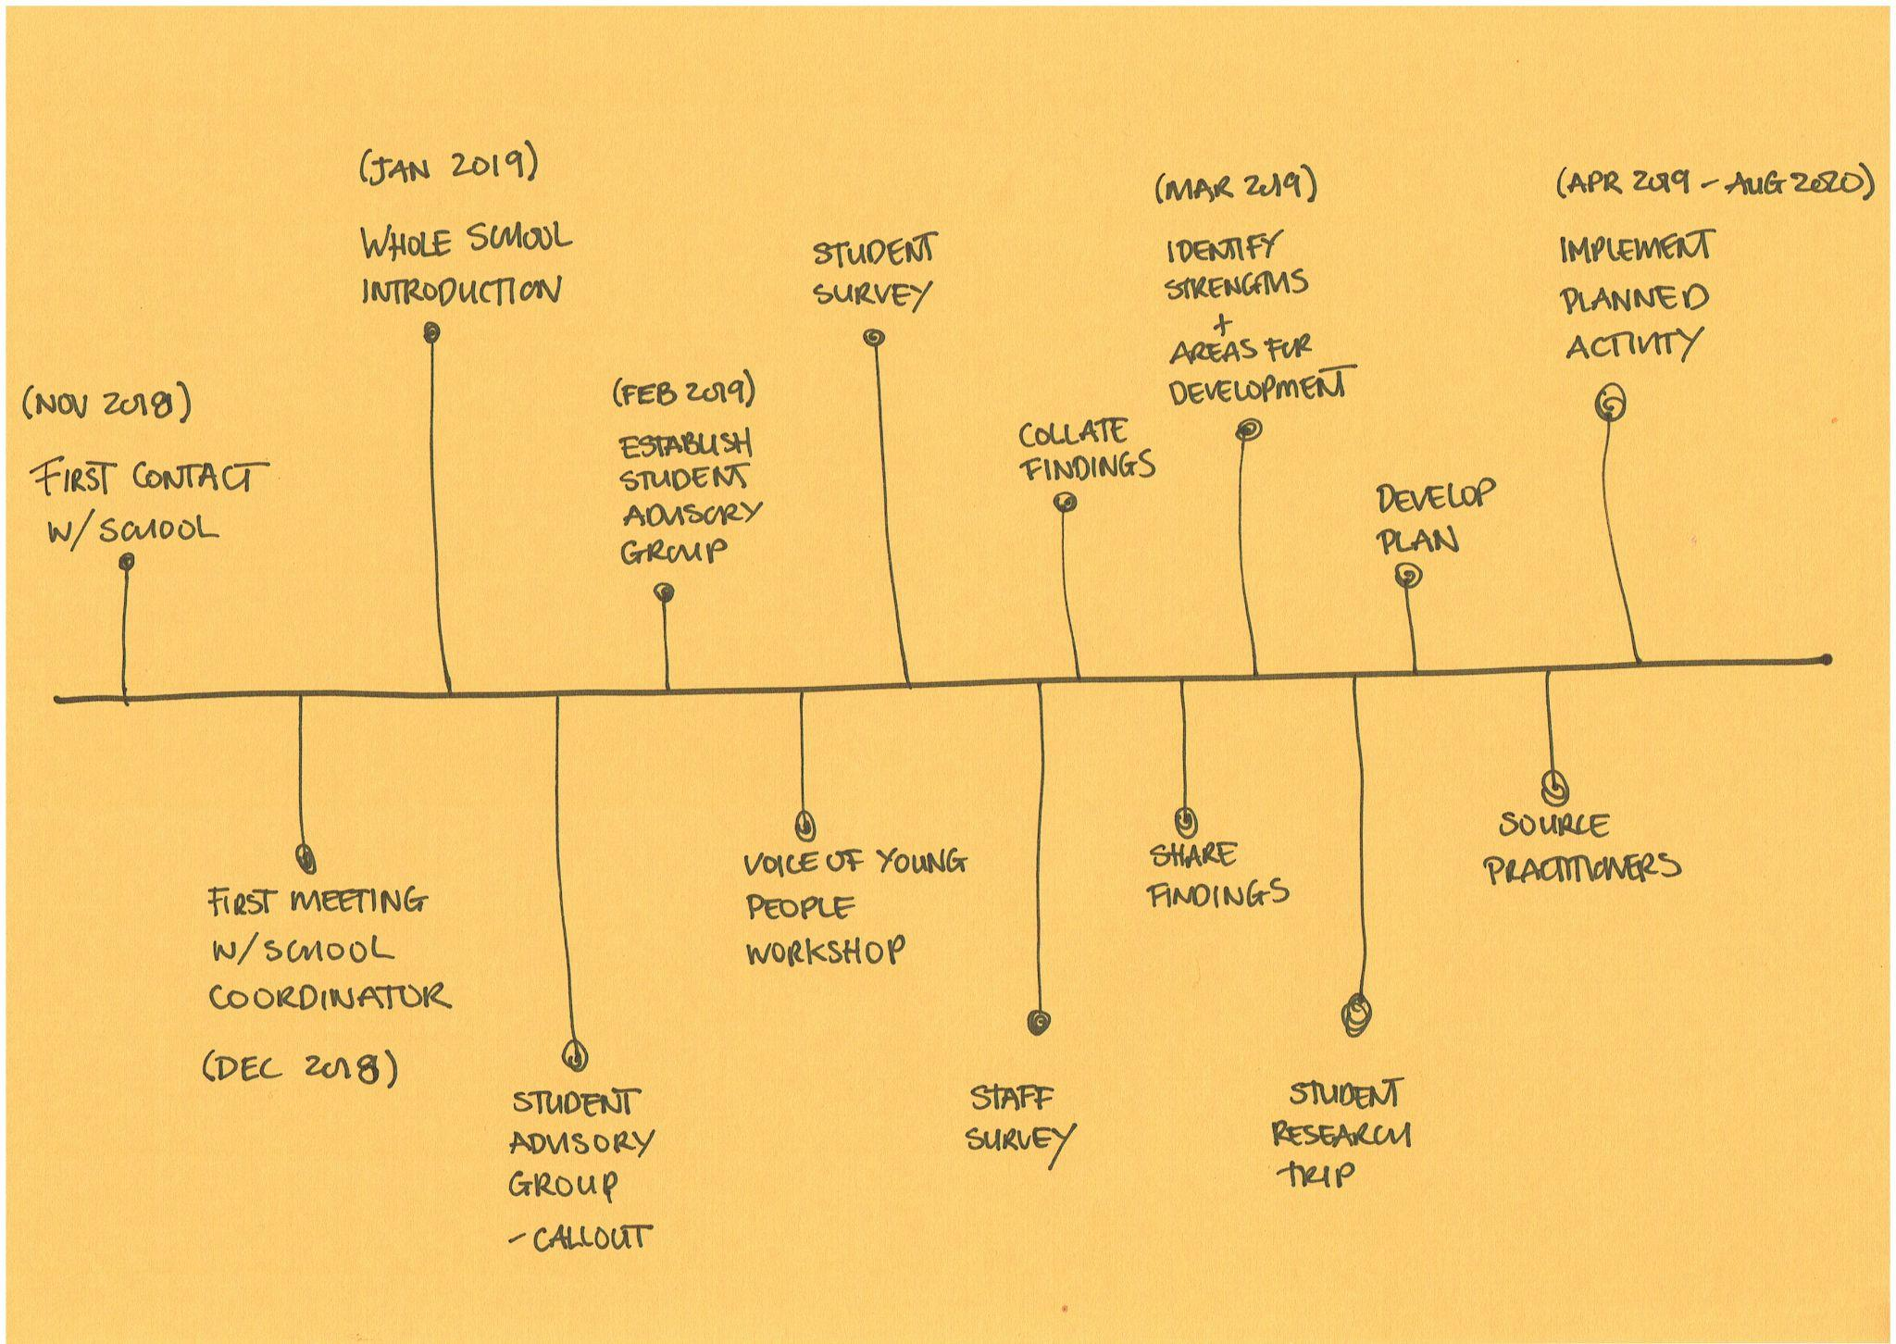
understand
Timeline with a focus on the UNDERSTAND phase
develop

Slide 4
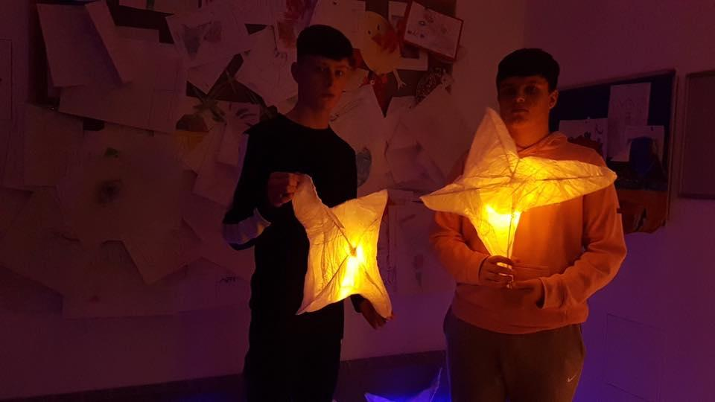
wellbeing
opportunities to SHOWCASE our talents
introduce more COLOUR in the SCHOOL environment
try NEW things
some of our FINDINGS
from the understand phase...
learning opportunities outside school environment
enhance school facilities
outdoor/sculptures using recycled materials

Slide 5
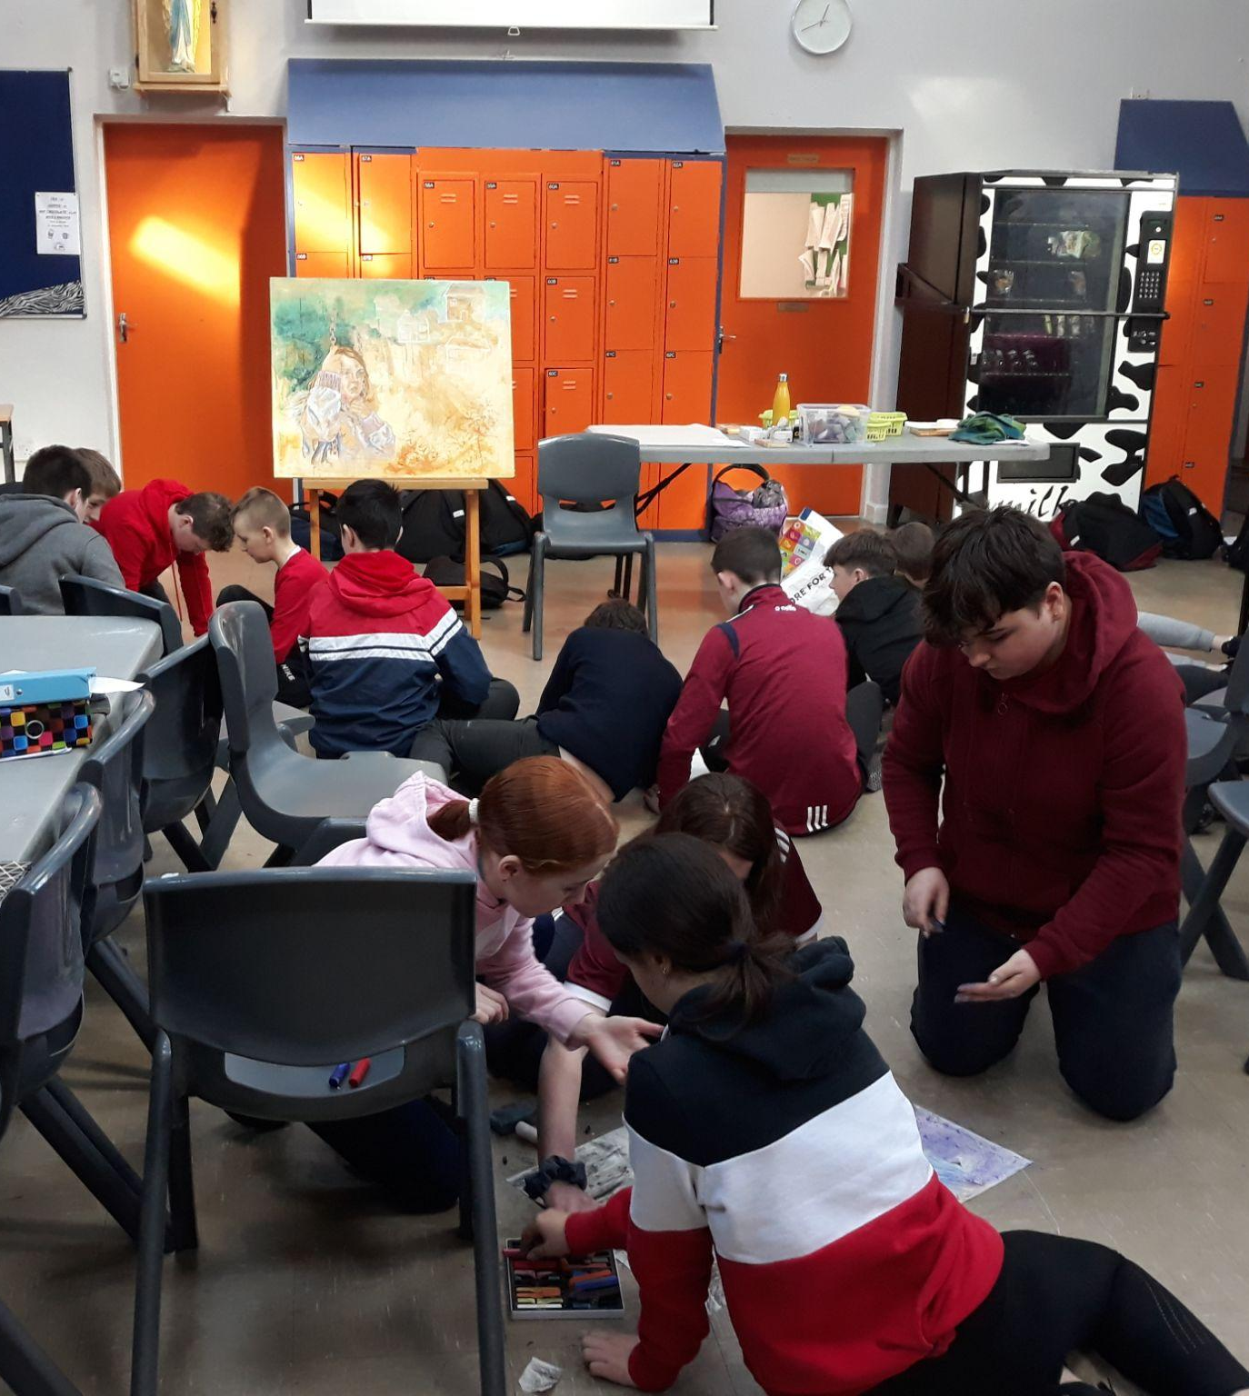
school vision
‘...ensure the school environment and the school activities reflect the imagination, energy and the voices of our young people…’
‘...ensure each member of our school community can experience the joy and excitement of expressing themselves through creative thinking & learning in their everyday experience of our school…’

Slide 6
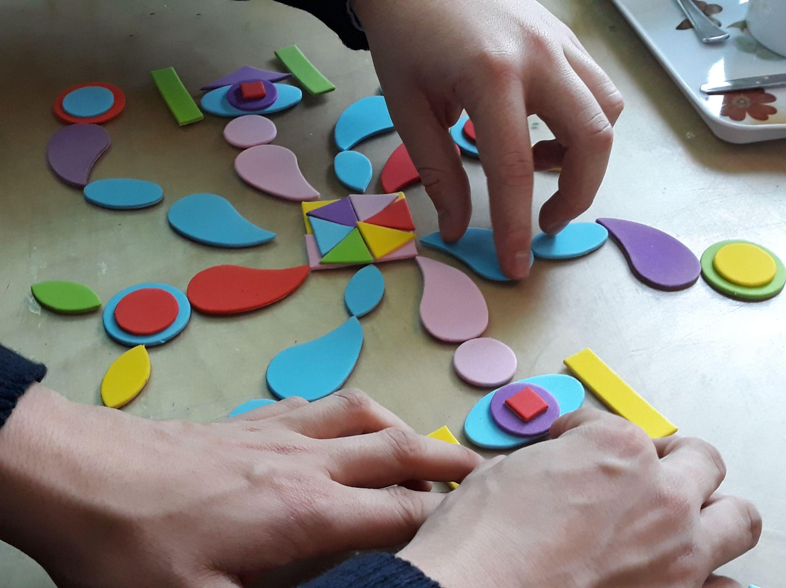
Make visible and reflect the creativity of our young people and school community
Create a mind-shift by celebrating the arts and creative practices beyond curricular achievement
Encourage young people to pursue their creative interests by supporting the development of student-led extra-curricular clubs and societies
aims of our creative school plan

Slide 7
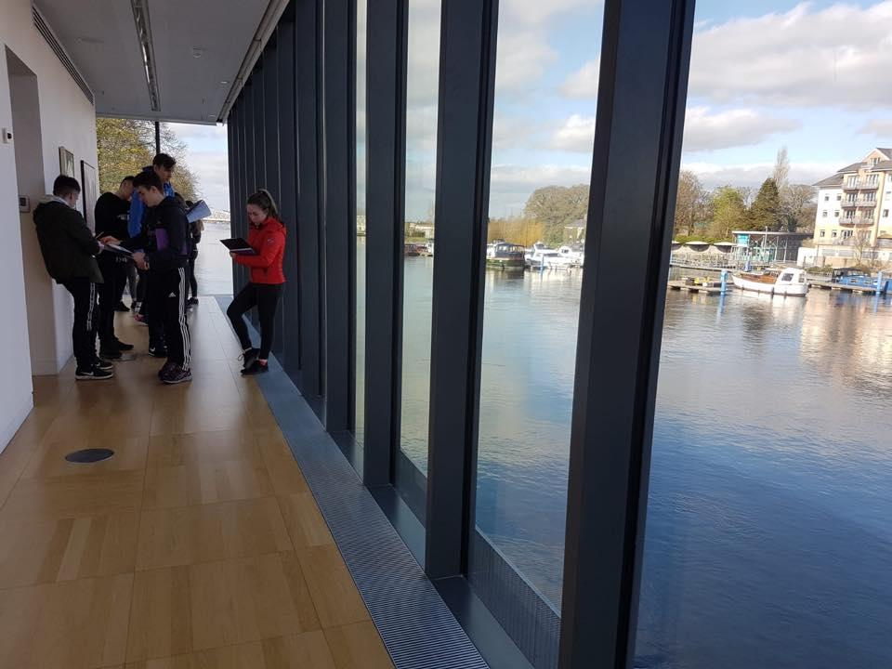
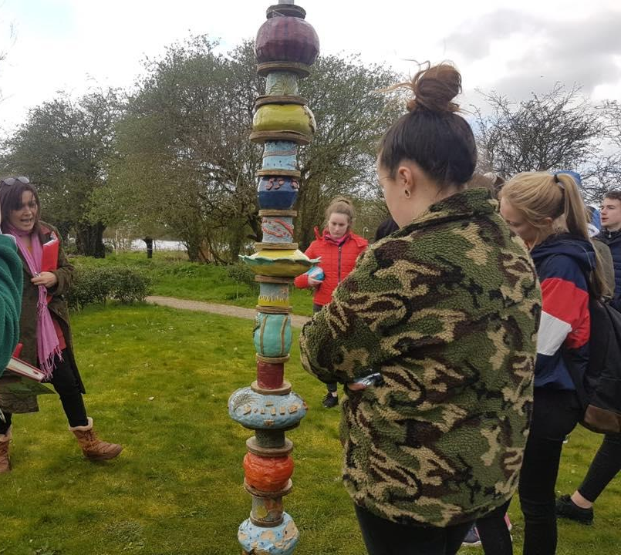
Student Advisory Group research trips; Luan Gallery, Athlone (left) & Dun na Sí, Moate
Tailored visiting experiences with a focus on design, planning spaces, architectural elements

Slide 8
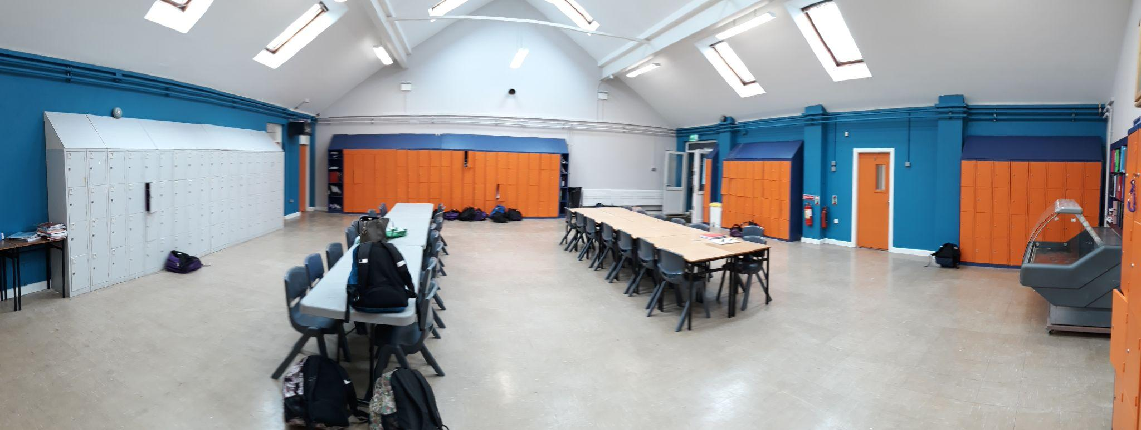
built environment impacts wellbeing
Priority area for development: changing the physical environment of the school

Slide 9
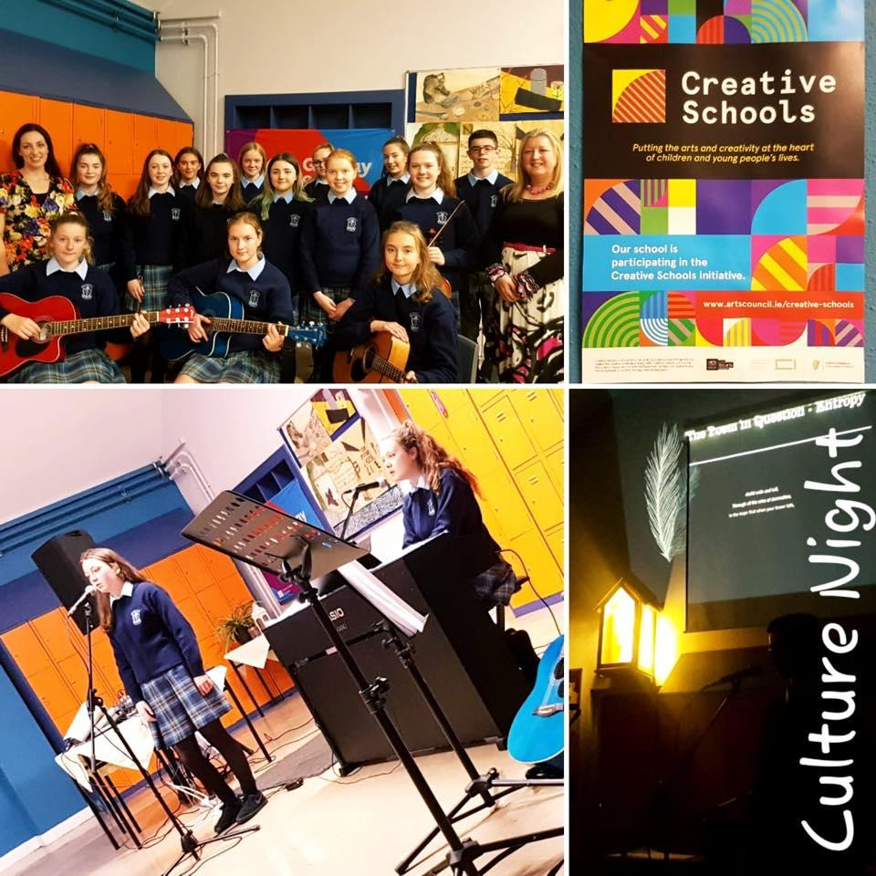
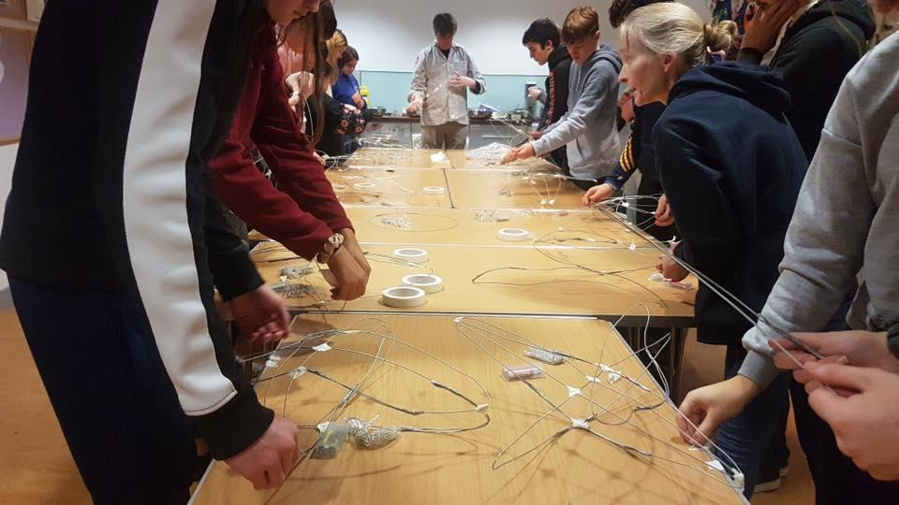
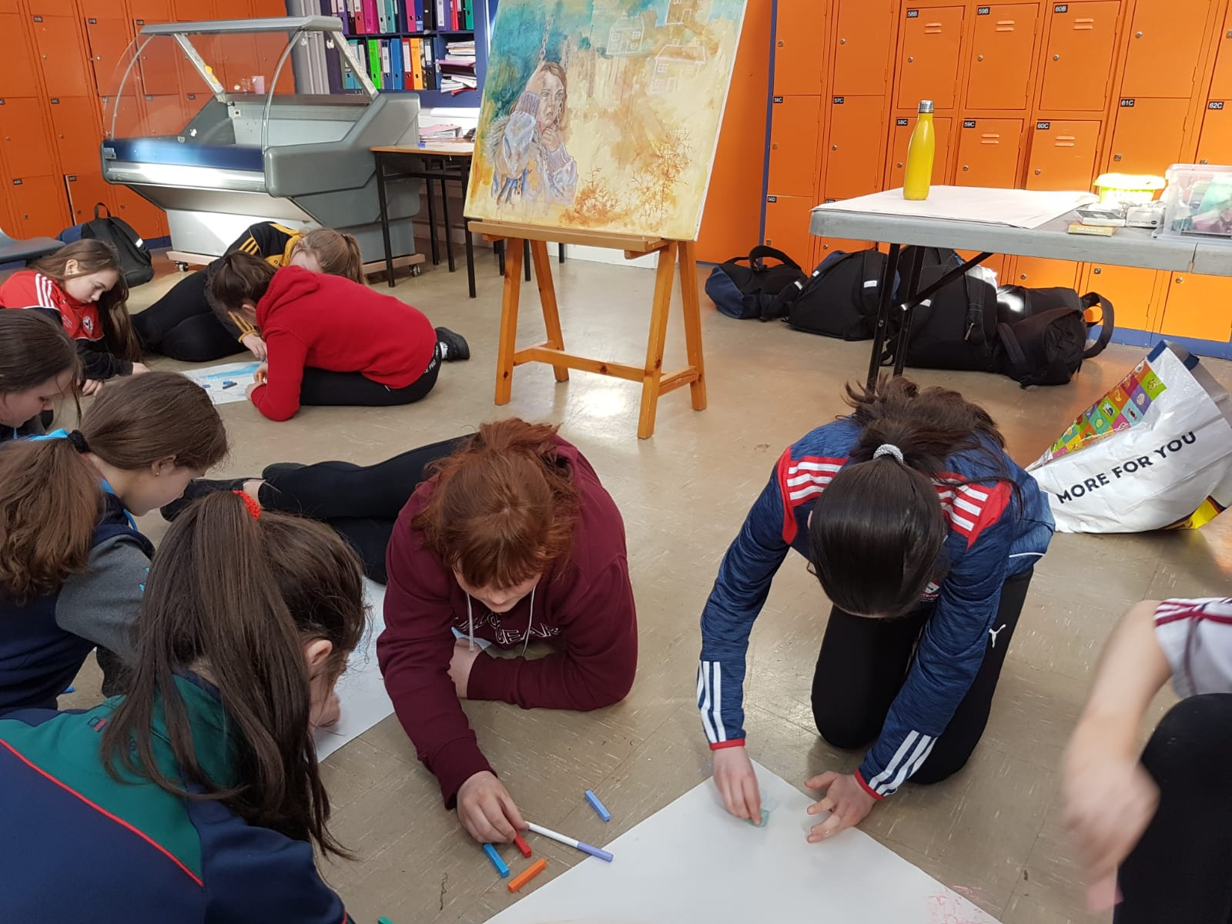
expanding external links
An evening of music, poetry and visual art for the wider school community
Integrating into Wellness Week 2020

Slide 10
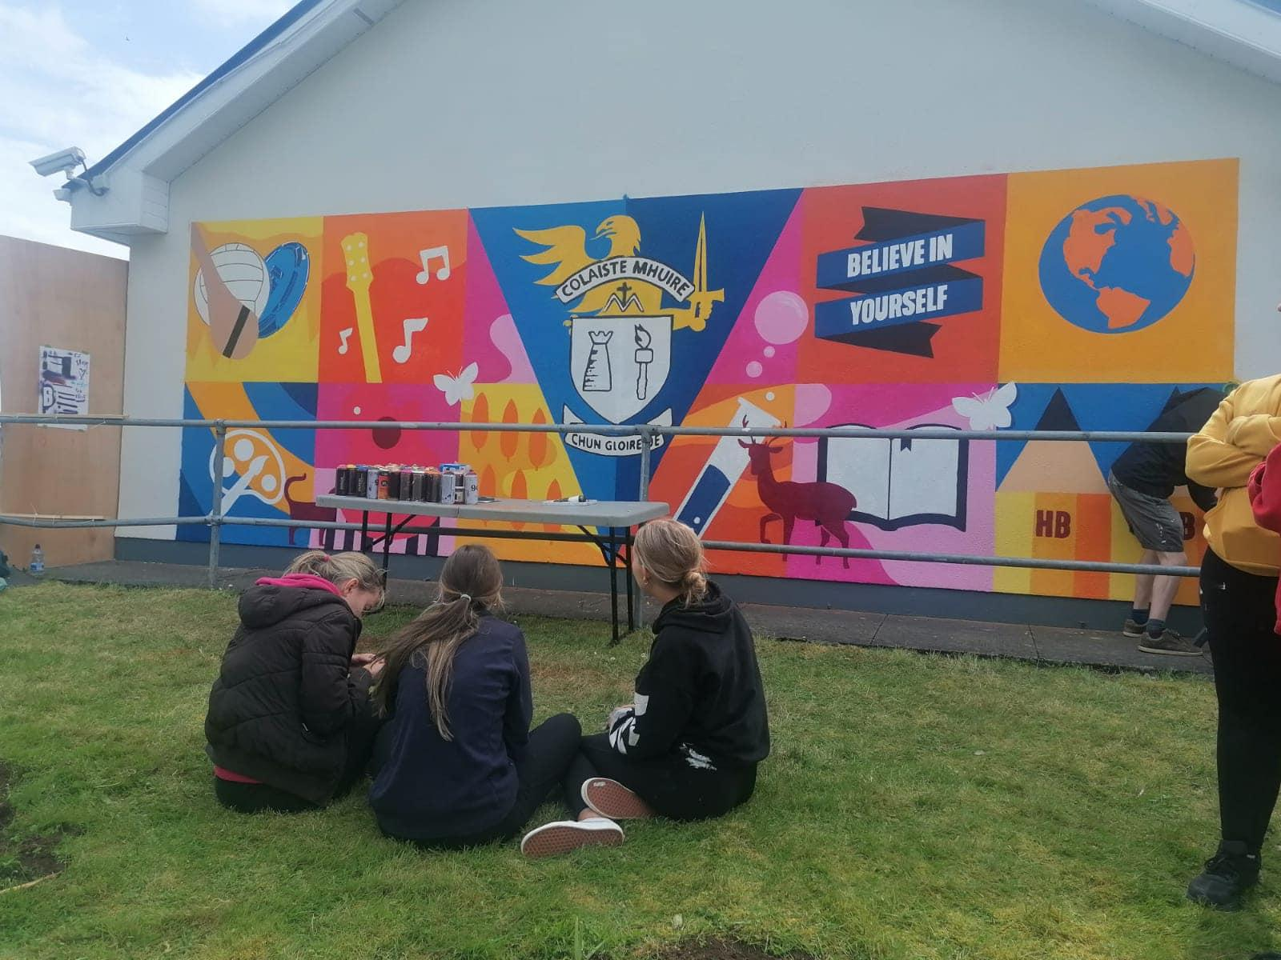
2023 the journey continues….CS Week
Artroom_ballygar

